Slide 1
ONE QUOTE非货代订舱客户的操作解决方案
OQ Direct Booking solution
(North/Central China)

Slide 2
纲要/SUBJECTs
-ONE e-COMM开户
Registration to ONE e-Commerce
-华中/华北口岸出口订舱生效后，于本地操作平台提交更改或订舱取消的的访问方式
Access to local website for OQ booking (ex North/Central China) amendment or booking cancellation
-如何更改订舱信息
-如何指定订舱代理
-如何指定集卡代理并创建无纸化设备交接单
-订舱取消
BKG amendment submission
To nominate booking agent
To nominate trucking company for EEIR creation and flow
BKG cancellation via LBS
与ONE直接付款买单的支付流程
访问电子支付门户进行人民币费用结算
美金支付流程
Payment process with ONE
On-line self-service for CNY payment
SOP of USD settlement

Slide 3
-ONE e-COMM开户
Registration to ONE e-Commerce

Slide 4
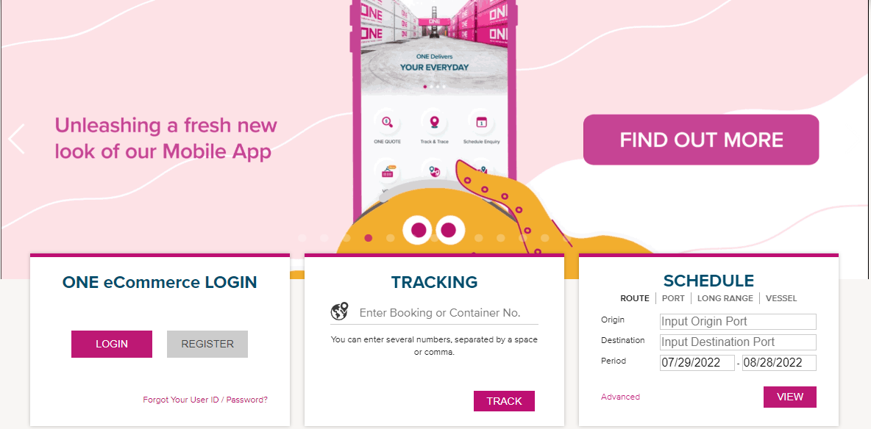
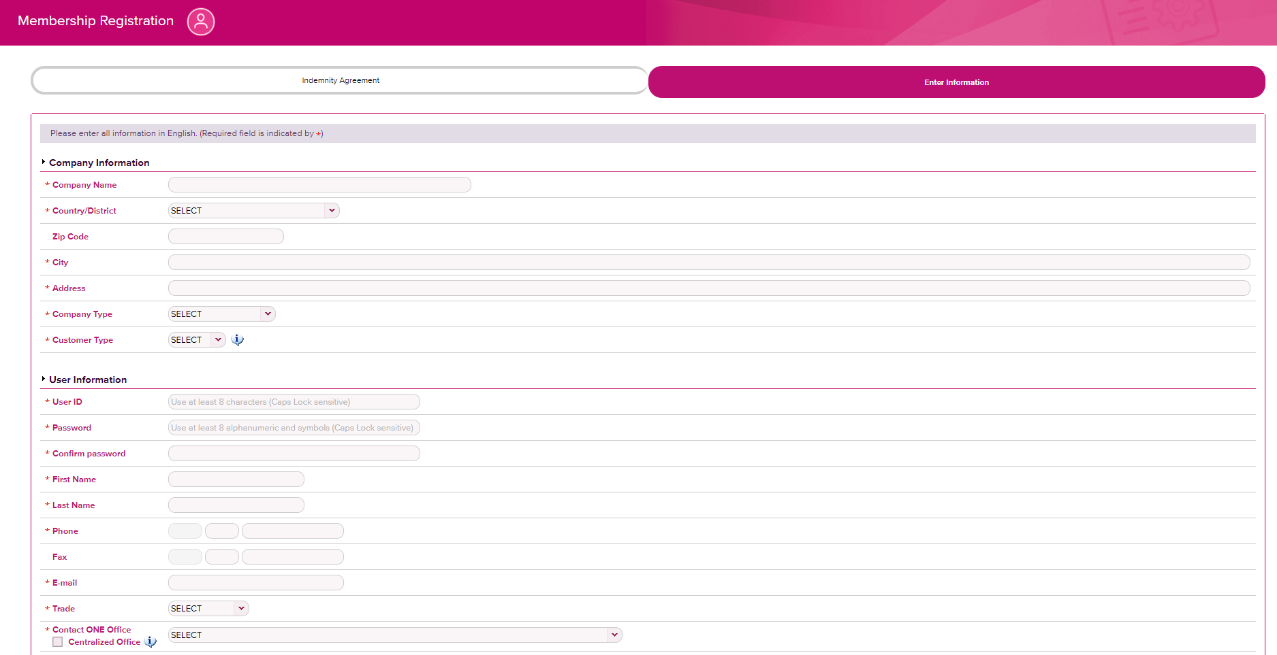
ONE e-COMM ID的登记开户 e-COMM ID registration
-访问ONE中文网站，在ONE eCommerce LOGIN中进行新账号的注册
-Access the ONE homepage and click ‘Register’ for new eCommerce ID registration .
https://ch.one-line.com/zh-hans
-填写正确且完整的信息（公司名，地址等请全部使用英文，注册邮箱不接受qq,163,126,gmail等域名的地址），并在Comment中备注开通ONE QUOTE功能
-Please fill the correct information with English and free domain of registered email address is not acceptable, then input ‘Open ONE QUOTE Access’ in the comment filed .

Slide 5
-华中/华北口岸出口订舱生效后，于本地操作平台提交更改或订舱取消的访问方式
Access to local website for OQ booking (ex North/Central China) amendment or booking cancellation

Slide 6
OQ订单的咨询及更改提交途径
Access to OQ BKG query/amendment
由以下网址进入OQ订舱更改的自助操作平台：https://cloud.easipass.com/epb/login/login_one.html
BKG amendment can be submitted via: https://cloud.easipass.com/epb/login/login_one.html
ONE电子商务平台中的聊天工具可提供人工在线答复；
ONE e-COMM platform provides on-line responses via “Livechat” to your queries

Slide 7
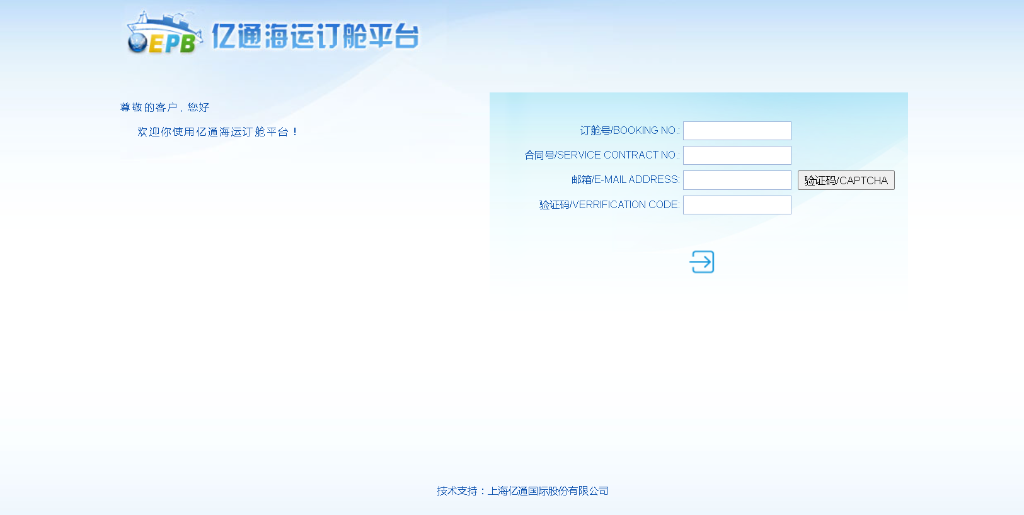
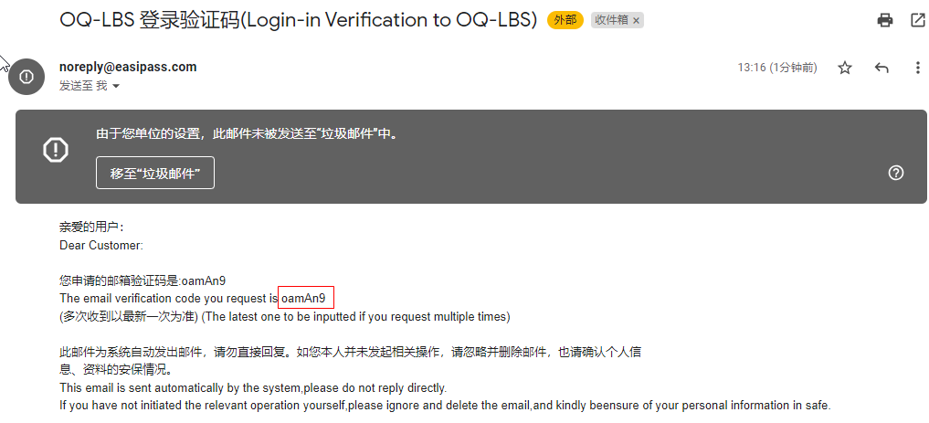
LBS操作提要
Description of LBS
不通过华中华北订舱代理的OQ订舱由ONE的系统自动生成订舱号以区别于货代的预配单号；
OQ booking placed by direct customer is confirmed by system auto-generated BKG# which can be distinguished to pre-assigned BKG# from booking agents;
OQ订舱经ONE审批接受后，可在LBS平台通过输入必须项后搜索到；
Only OQ confirmed booking is available on LBS after fill up of mandatory items to access;
必须项中客户需要输入有效的工作邮箱获取验证码，并在发送验证码10分钟内完成进入
Auto message will be delivered a captcha to user’s email box, and please “enter” within 10mins when captcha dispatched

Slide 8
-如何更改订舱信息
-如何指定订舱代理
-如何指定集卡代理并创建无纸化设备交接单
-订舱取消
BKG amendment submission
To nominate booking agent
To nominate trucking company for EEIR creation and flow
BKG cancellation via LBS

Slide 9
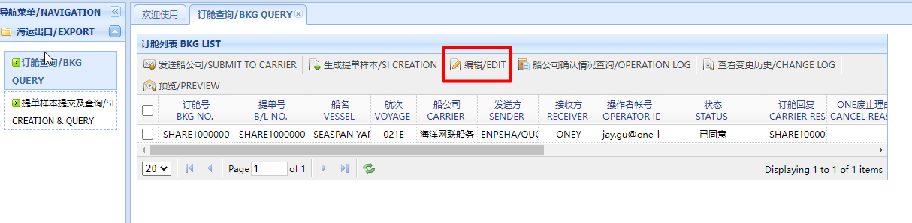
LBS操作提要 – 编辑更改
Description of LBS – BKG amendment
使用编辑键，客户可在现有的订舱内容中添加信息或编辑允许更改的项目
“EDIT” keyword enables customer to submit addition booking information and amendment to ONE local office

Slide 10
按OQ订舱规则，以下列表中会引发运费改变的订舱项目已被锁定无法操作，客户可选择在LBS或在OQ界面提交订舱取消；
The booking items listed in the table are blocked to amend in according to T&C of OQ booking, or customer can submit BKG cancellation from this UI directly or via OQ platform；
LBS操作提要 – 编辑更改
Description of LBS – BKG amendment
由于船期更改，仅ONE操作人员可以在双方同意情况下对船名，航次及航线代码此三项进行更改
ONE operator can make BKG rollover or VSL/VOY/LINE code amendment on base of mutual consent because of schedule change
订舱号 | Booking No.
交货条款 | Receipt/Delivery term
运输协议号，服务合同和 | Rate Filing Agreement, Service Contract No.
船名 | Vessel Name
航次 | Vessel Voyage
航线代码 | Line Code
路径涉及的港口部分 | Route/Port(Point) code
货物信息中不可改为危险品 | General commodity cannot be changed to DG
箱型不可改 | Container Type cannot be changed
同箱型的箱量可减少，但不接受增加 | Container Volume cannot be increased
COC箱不可更改为SOC | COC cannot be changed to SOC
√
√
√

Slide 11
按OQ订舱规则，订舱确认后，如需减少同箱型的订舱箱量，客户按OQ订舱时选择的服务项目（例如优享或特别推广产品）以及更改提交的时间，或将被收取相应的亏舱费。
If the Merchant wishes to reduce the number of containers after the Booking Confirmation has bee issued, then request of volume decrease is subject to Booking Cancellation Fee "CCL") per TEU in accordance with T&C related rules
LBS操作提要 – 编辑更改
Description of LBS – BKG amendment
订舱号 | Booking No.
交货条款 | Receipt/Delivery term
运输协议号，服务合同和 | Rate Filing Agreement, Service Contract No.
船名 | Vessel Name
航次 | Vessel Voyage
航线代码 | Line Code
路径涉及的港口部分 | Route/Port(Point) code
货物信息中不可改为危险品 | General commodity cannot be changed to DG
箱型不可改 | Container Type cannot be changed
同箱型的箱量可减少，但不接受增加 | Container Volume cannot be increased
COC箱不可更改为SOC | COC cannot be changed to SOC

Slide 12
LBS操作提要 – 编辑更改
Description of LBS – BKG amendment
以下列项均可在LBS界面中完成信息添加或更改
The listed BKG items can be added or modified via LBS
发货人 | Shipper
收货人 | Consignee
通知人 | Notify Party
特殊装载要求 | Special Stowage
运费条款 | Freight Terms
联系人邮箱 | Contat E-mail Address
货代 | Booking Agent
车队 | Truck
货物信息中仅“普通”与“化工品”可互改 | General commodity includes Non-DG chemical
包装件数 | No. of PKG
包装类型 | Package Code
包装说明 | Package Description
货类代码 | HS Code
体积 | Measurement
货毛重 | Gross Weight
唛头 | Marks & Numbers
货物描述 | Description of Goods
放箱要求中提箱点需求 | Depot nomination of Empty Pick-up
放箱要求中已提箱/箱号 | CNTR# & Seal# for COC held by SHPR/BA
附件 | Attachment
作废 | Cancel
付款人名称 | Payer Name
纳税人识别号码 | TAX Identification Number
纳税人联系电话 | TAX Payer Contract Number
电子邮箱（接收电子发票） | Email Address
银行名称 | Bank Name
银行帐户 | Bank Account Number
纳税人地址 | Tax Payer Address

Slide 13
LBS操作提要-货代指定
Description of LBS – BKG agent nomination
ONE华中华北的签约代理在其自愿原则下，可以要求ONE当地公司将其公司列入可被OQ直接订舱客户选为代理的清单中
The signing agents of ONE in North and Central China can be on a voluntary basis to request ONE local office to include its company in the agent list in order that can be selected by OQ direct booking customer

Slide 14
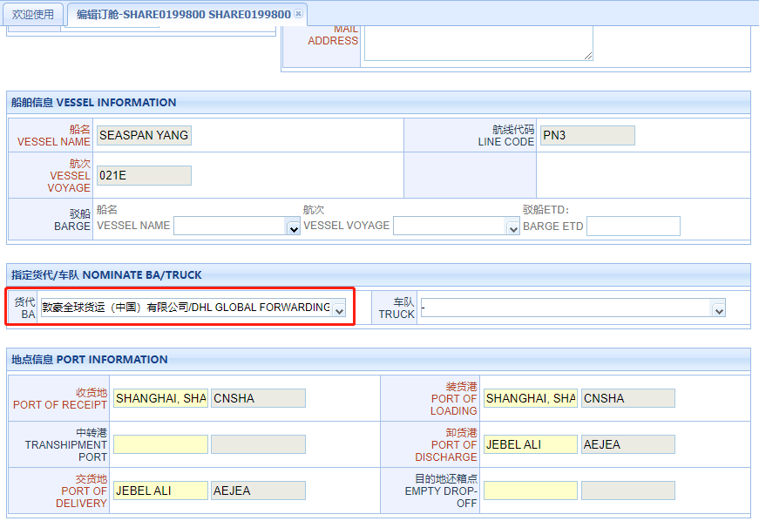
LBS操作提要-货代指定
Description of LBS – BKG agent nomination
LBS订舱中可下拉显示ONE在当地的签约代理；
ONE signing agent list can be displayed after pull down of “BKG agent”;
选定货代提交后，经ONE操作确认，被指定的货代会收到由系统触发的提醒邮件，此票订舱也会同时显示并允许货代在其现有的界面进行操作；
When ONE confirms amendment to BKG agent nomination, the Agent will be delivered an email notification and this OQ booking can be searched at agent’s UI;
指定了货代的OQ订舱，完成出运后ONE与货代进行提单签发和运费结算
BL issuance & Freight settlement will be re-directed to BKG agent i/o OQ booking customer after export

Slide 15
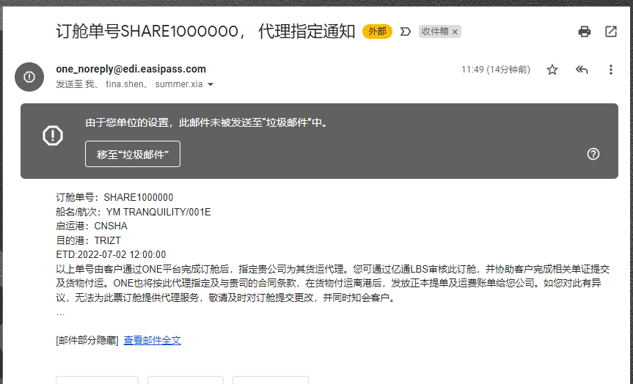
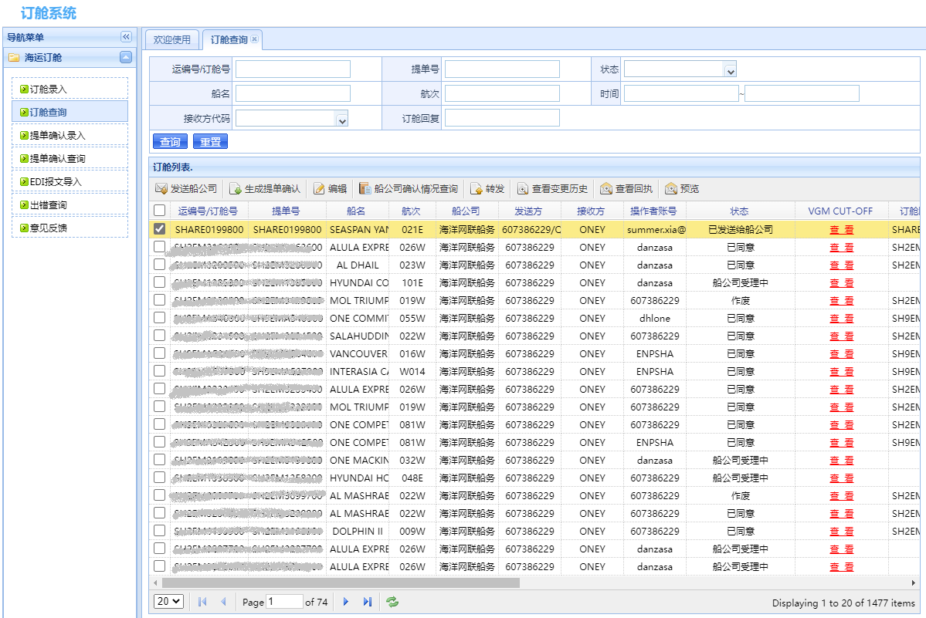
LBS操作提要-货代指定
Description of LBS – BKG agent nomination
代理被指定的通知邮件样本
The sample of alert message when BKG agent be nominated
代理界面显示
OQ booking to be displayed to the UI of the agent

Slide 16
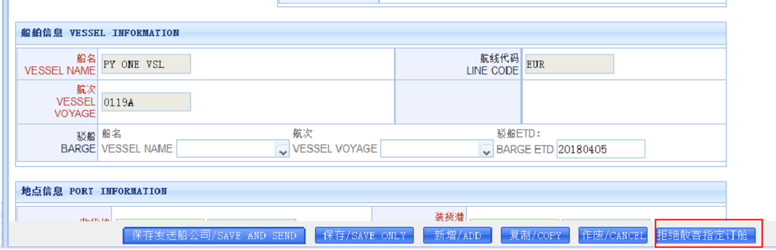
LBS操作提要-货代指定
Description of LBS – BKG agent nomination
在货代的操作界面，对OQ客人指定可以通过新增的操作键“拒绝散客指定订舱”完成货代信息的清空，务必不要直接使用“作废” ；
Booking agent may tick newly added button “decline nomination” from their UI on base of their business justification, cancel directly is not proper action to refuse the nomination
货代清空指定被ONE受理完成后，LBS对提交指定的操作邮箱发送邮件提示货代拒绝
After booking agent’s denial is reviewed by ONE, LBS will trigger the alert message to the designated operation mailbox
subject： 货代指定被移除/The designated booking agent removed
亲爱的客户，
您的货代已提交拒绝指定，请与他们线下联系后重新提交指定，或者您可以选择在装载后直接向ONE付款。
Dear customer, The Booking Agent has declined your designation, please contact with them offline to renominate or you can select to settle payment with ONE directly after loading.

Slide 17
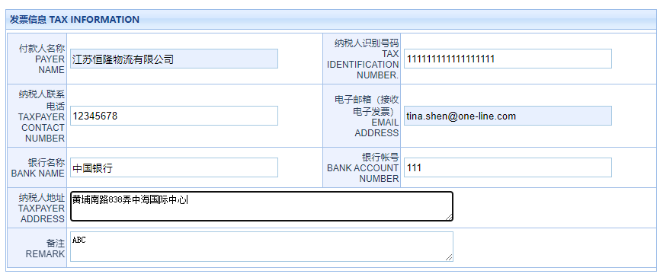
LBS操作提要-无指定货代等同于付款买单
Description of LBS – Nil of BA nomination
LBS操作中的货代指定不是必须项，货代选项为空时，默认为此订舱在出运后，客户与ONE付款买单；
Null of BKG agent column under LBS, ONE defaults as bill release on receipt of payment;
付款买单的客户，请事先确保在您的支付银行开通B2B业务；
ONE adopts B2B on-line payment for RMB invoice, The precedent requirement to the customer is to activate your online banking B2B payment function;
付款买单的订单，需由客户与船开前在LBS以下图示项目中正确填写美金费用的发票信息，所有华中华北口岸出口的付款买单的订单支付, 统一汇入ONE(上海）的美金银行账号，并集中由ONE上海的财务部回复支付中的问题
The customer is requested to properly fill in the invoice information in LBS before vessel departure in order that ONE can timely issue Tax invoice for your payment. Payment in USD will be unified receiving bank at ONE(Shanghai) regardless export location, and the financial department of ONE(Shanghai) can be the contact window for your payment queries.

Slide 18
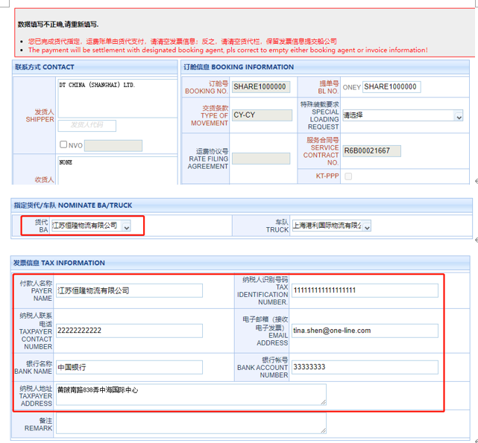
LBS操作提要-货代指定
Description of LBS – BKG agent nomination
指定代理或发票信息项下的内容输入不可同时存在，如错误填写，保存提交时系统会弹出警示并无法完成下一步操作
“BKG agent” & “TAX information” are either-or pattern for customer’s fill-up, or system will pop-up a warning when user clicks “Save&Submit”

Slide 19
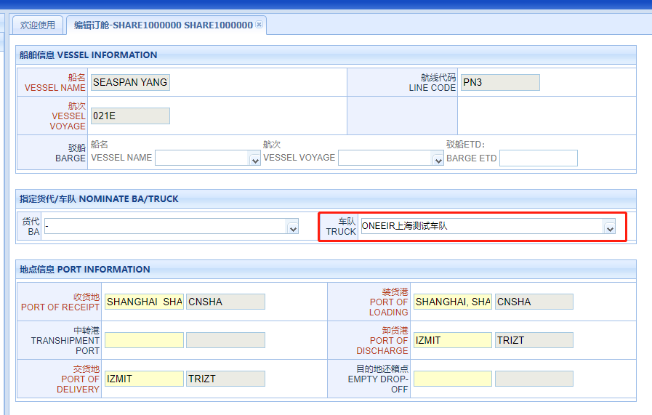
LBS操作提要-车队指定
Description of LBS-Truck nomination
客户需要在LBS订单中完成车队的指定，下拉可显示ONE在当地的合约车队；
The customer is required to select ONE’s local contract fleet to complete the assignment of “truck“ under LBS;
缺失此项的指定，将无法生成放箱指令及发送电子设备交接单到相关的码头，即提箱，陆路运输，进港等事项均无法正常操作，订舱也将最终无法出运
Null of this designation will not be able to generate EIR notification/EEIR to the relevant depot and terminal, that stops operation of empty pick-up, land transportation and laden gate-in..etc to ultimately result unable to shipment

Slide 20
LBS操作提要-车队指定
Description of LBS-Truck nomination
除上海以外，客户在LBS订单中完成车队的指定，系统会向指定公司发送提醒邮件；
Other than POL=SHANGHAI, the truck company will be delivered an email notification when customer submits truck nomination into LBS;
如被指定的车队公司拒绝提供服务，订舱客人需要联系其他有意向的车队并在LBS提交车队更改完成新的指定
If the truck company declines to provide service, customer has to contact with other candidates prior to amend the assignment at LBS.
SUBJECT: 单号xxx，ONE QUOTE客户提交车队指定
客户（显示操作邮箱）指定您公司为其进行小票生成，放箱指令等箱运操作，
敬请协助。除小票及放箱等服务外，您公司无权对此订舱数据进行更改或其他
后续单证操作，如有异议，可通过前述邮箱与客户联系。

Slide 21
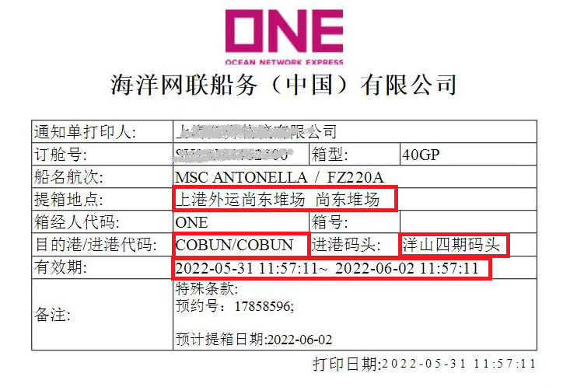
LBS操作提要-车队指定
Description of LBS-Truck nomination
指定后的车队才有权限生成放箱小票/通知单，同时ONE的后台系统结合订舱数据对堆场及码头发指令并建立正确的电子设备交接单数据
Only designated trucking company is authorized to generate EIR notification, therefore ONE backend system automatically dispatches EEIR to ensure proper information delivery to depot and terminal
Truck company
Depot for EQ release
Gate-in Code
Gate-in Terminal

Slide 22
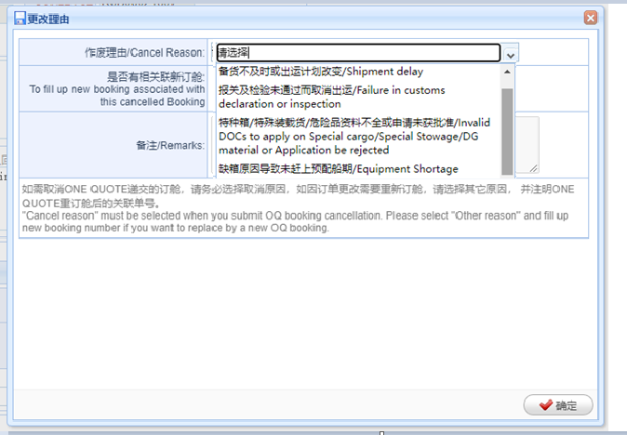
LBS操作提要-订舱取消
Description of LBS-OQ BKG cancellation via LBS
如在LBS完成对OQ的订舱取消，请务必选择取消原因，如因订单更改需要重新订舱，请选择others， 并注明ONE QUOTE重订舱后的关联单号；
To cancel OQ booking via LBS, please be sure to select proper cancel reason. If this OQ booking should be replaced by newly placed one, the cancel reason should be selected “other” and indicate associated OQ booking number

Slide 23
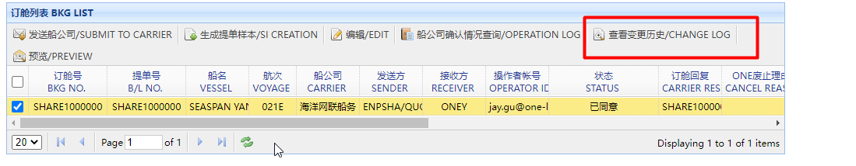
LBS操作提要
Description of LBS
所有用户的操作动作可以在日志中被完整记录及展示
The every act by OQ booking customer, nominated BKG agent or ONE operator can be fully recorded in the “CHANGE LOG”

Slide 24
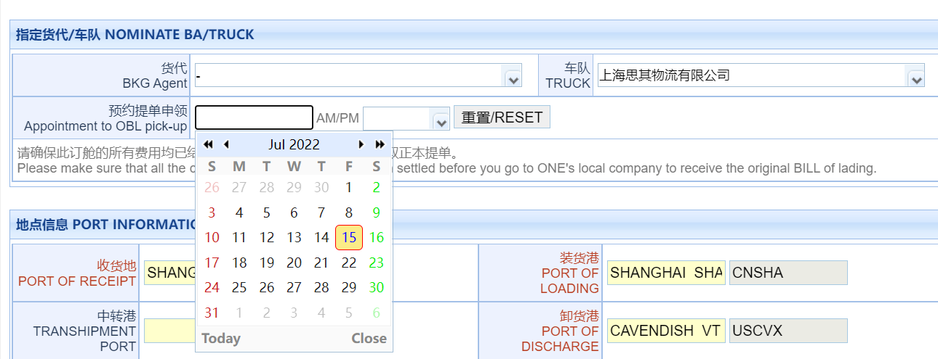
预约领单
Reserve your BL pick-up
付款买单的客户，请提前在LBS的订舱下完成取单预约并保障前往ONE当地公司取单前完成各项费用的支付
When customer goes through the freight payment with ONE, you can make an appointment at LBS to pick up original BL at ONE local office

Slide 25
与ONE直接付款买单的支付流程
访问电子支付门户进行人民币费用结算
美金支付流程
Payment process with ONE
On-line self-service for CNY payment
SOP of USD settlement

Slide 26
ONE付款买单的支付要求
Freight Settlement with ONE
在使用电子支付之前，请阅读并确认您是否可以接受以下条款：
Before using ONE ePayment, please read and confirm if you can accept the following terms:
1. ONE电子支付目前只支持人民币付款。
ONE ePayment only supports CNY payment.
2. ONE电子支付采用B2B线上付款方式，您需要联系您的银行开通网银B2B支付功能。
ONE ePayment adopts B2B online payment method. You need to contact your bank to activate the online banking B2B payment function.
3. 付款成功后系统会根据您提供的信息开具增值税电子普通发票，并发送至您预留的邮箱地址。一笔付款开具一张增值税电子普通发票。
System will issue VAT E-invoice （Normal）based on the information you provided after payment and send it to your email box， one invoice for each payment.
4. 美元支付 ： 1) 请向ONE申请开具美元增值税电子普通发票；
2) 收到美元增值税电子发票（开票日）两个工作日内完成美金支付；
3) 付款成功后，请向ONE指定邮箱（cn.db.collection@one-line.com）发送付款通知书和水单。
USD payment: 1) please apply to ONE to issue USD VAT E-invoice,
2) complete USD payment by two working day when you receive USD VAT E-invoice （Normal）
(according to invoice issue date),
3) After payment, please send payment advice and bank slip to ONE email box（cn.db.collection@one-line.com）.
如果条款与您现有流程有冲突，请联系代理完成付款。
If any terms conflict with your company process, please contact the booking agents to arrange payment.

Slide 27
人民币费用结算
RMB on-line payment
如何访问电子支付
How to Access ePayment
这是中国市场使用ONE完成ePayment（电子支付）的用户指南。 这可能适用于您的国家，也可能不适用。
This is the user guide of Chinese market for completing ePayment with ONE. This may or may not be applicable to your country.
访问电子支付门户
Access
ePayment Portal
如何创建采购订单
How to Create a PO
如何支付采购订单
How to Pay a PO

Slide 28
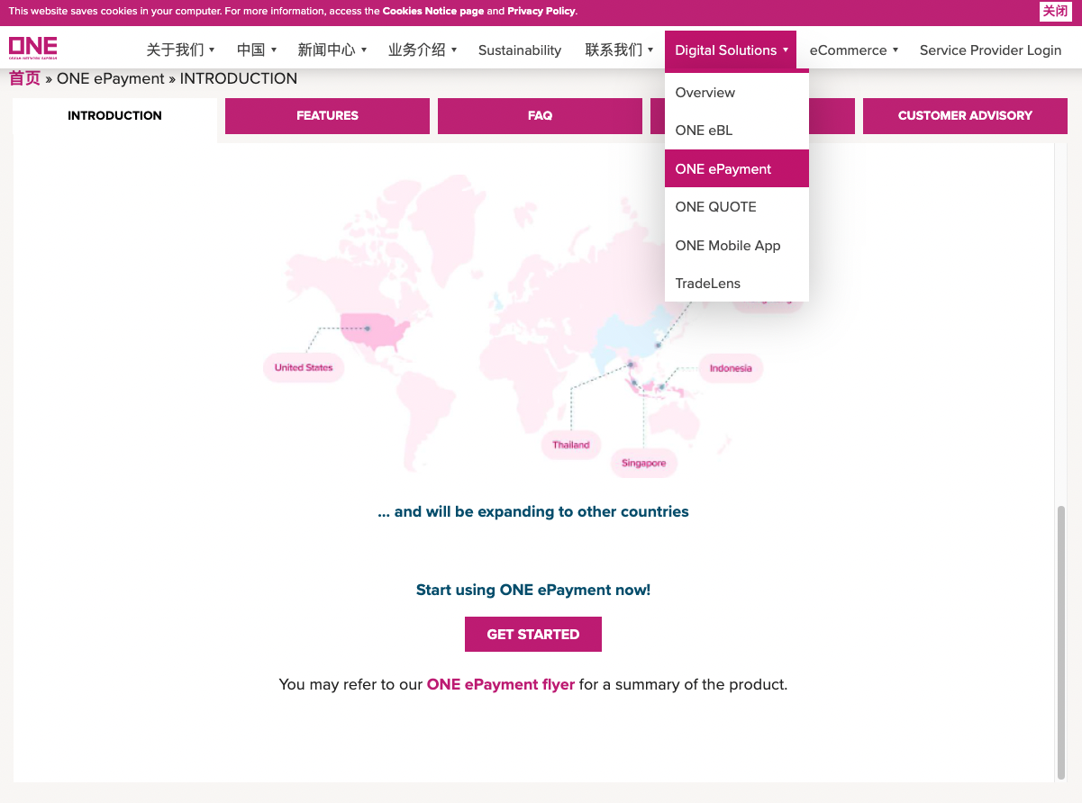
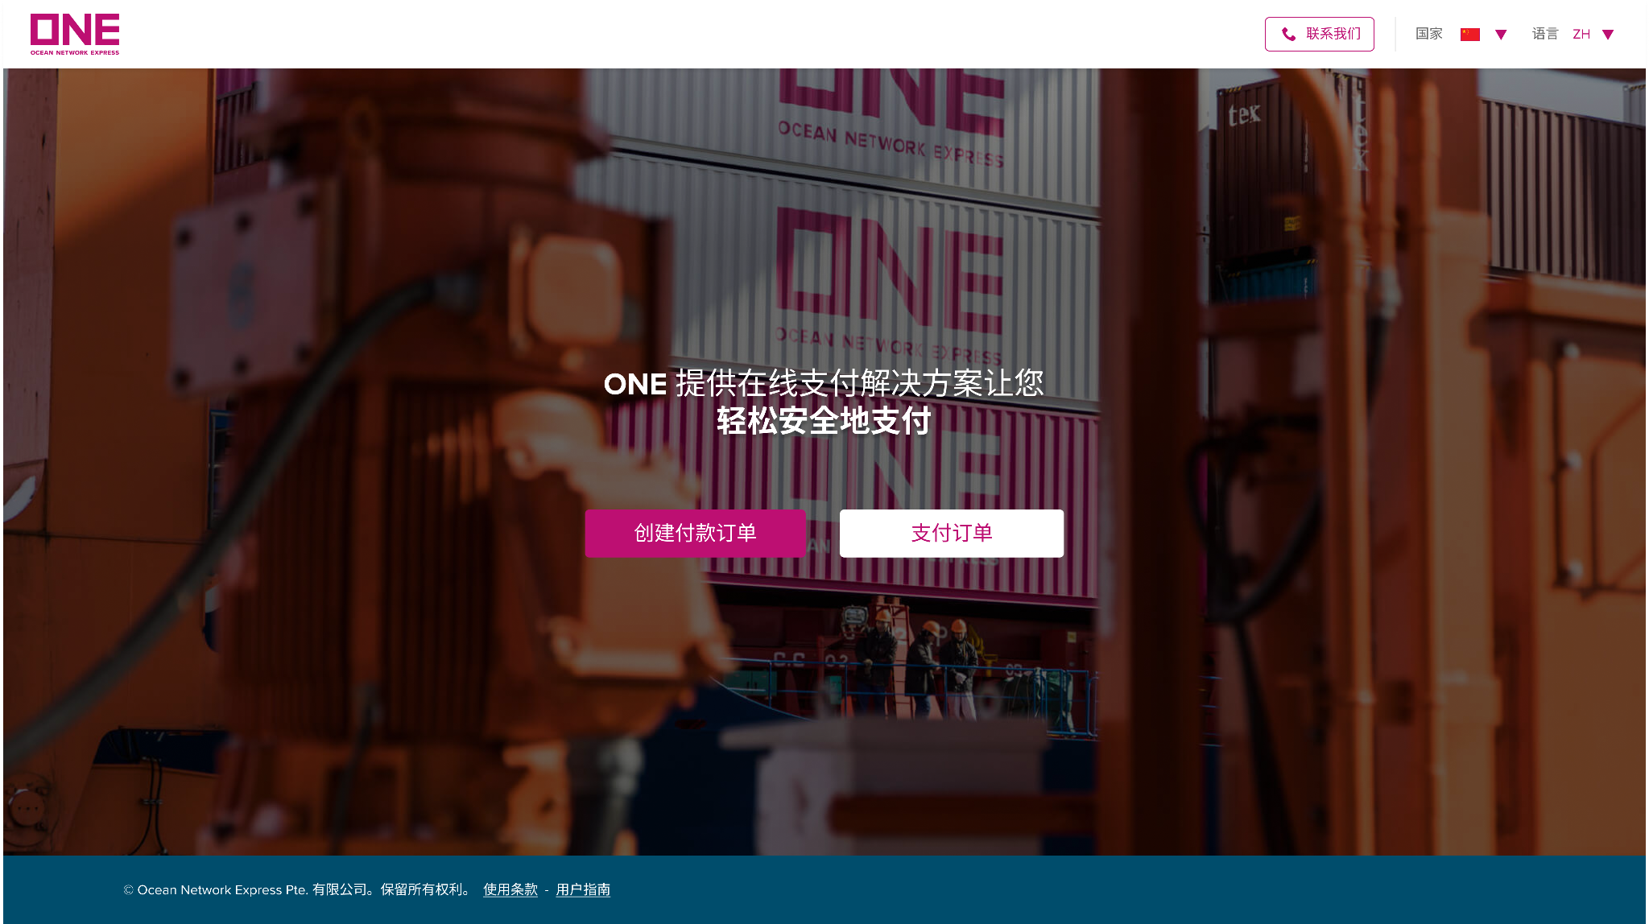
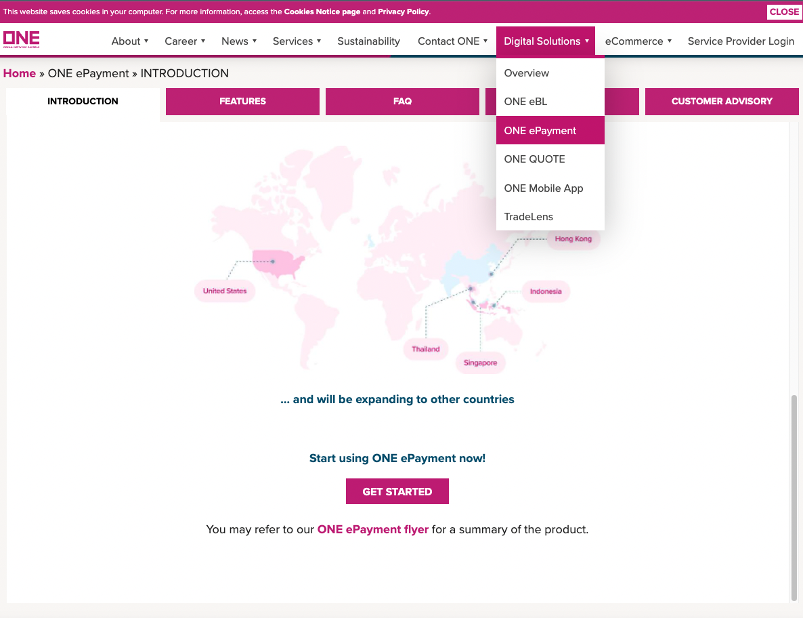
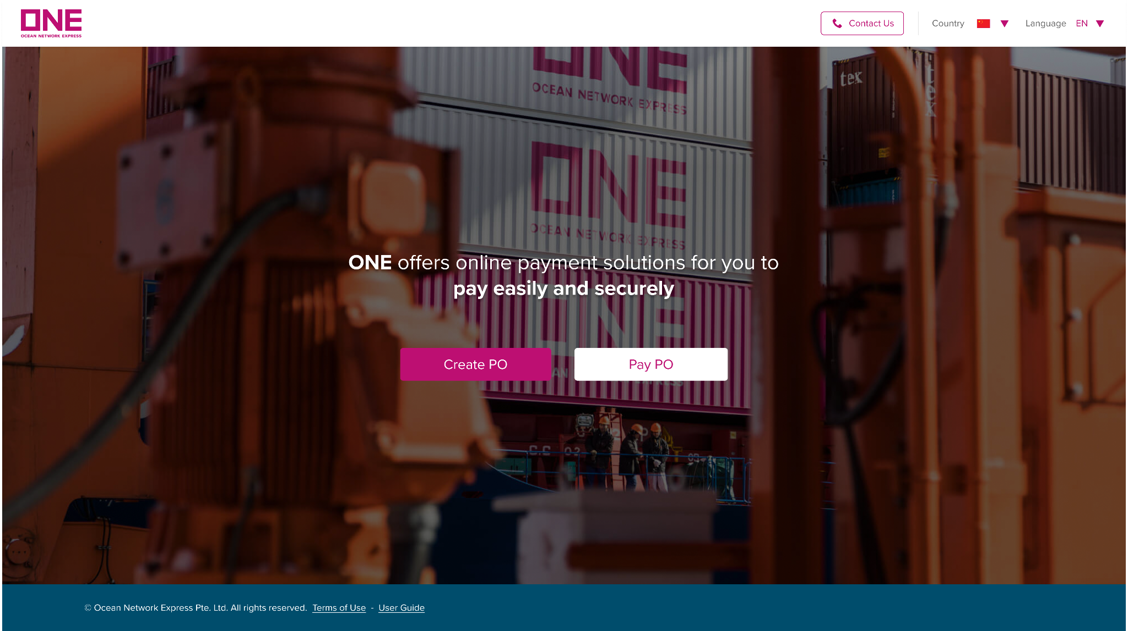
人民币费用结算
RMB on-line payment
访问电子支付门户 （Access ePayment Portal）
通过在浏览器中输入链接 http://epayment.one-line.com/#，您将被引导至 ONE ePayment 系统。
By entering the link http://epayment.one-line.com/# in your browser, you will be directed to ONE ePayment system.
或者在访问 https://ch.one-line.com/ 或 https://one-line-services.com.cn/ 时，点击主菜单中的数字解决方案，可以在子菜单中找到 ONE ePayment 点击打开 ePayment 链接
Or you can find ONE ePayment in the submenu of Digital Solution on the header of https://ch.one-line.com/ or https://one-line-services.com.cn/

Slide 29
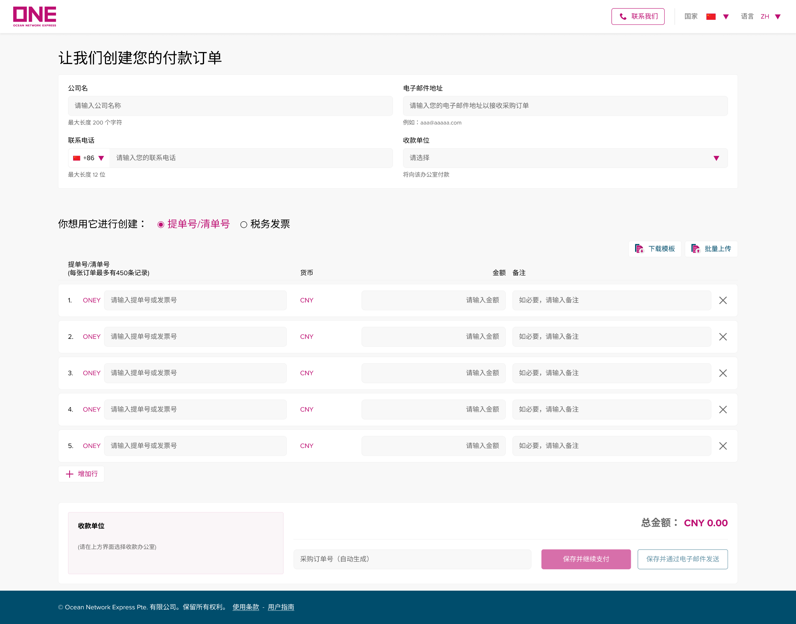
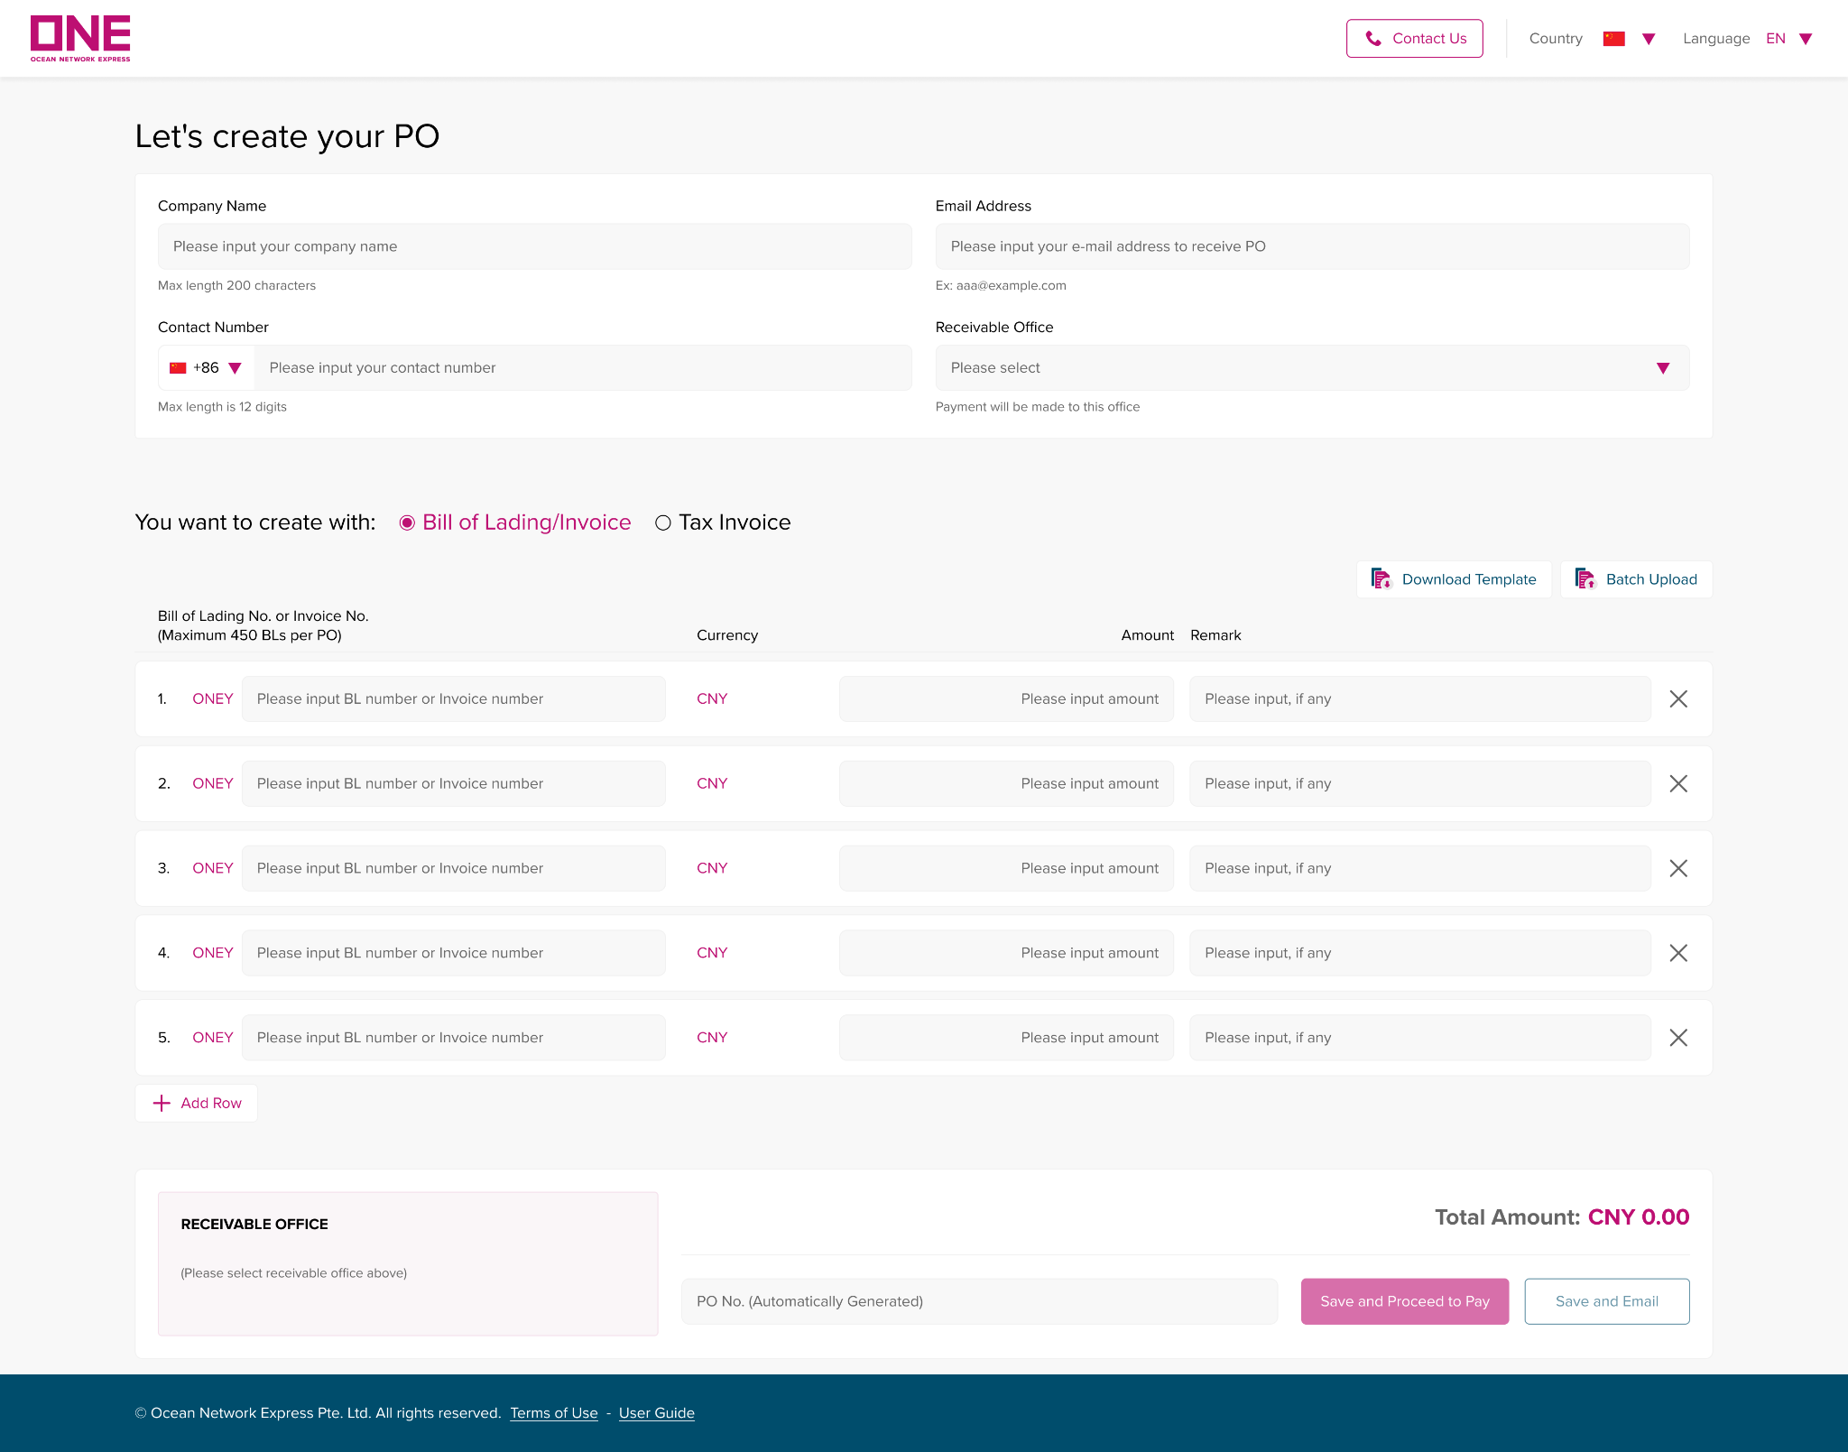
人民币费用结算
RMB on-line payment
访问电子支付门户/How to Create a PO
为了创建一个新的 “采购订单”，点击 “创建付款订单” 按钮，这将打开一个新的采购订单创建页面。
To create a new “Purchase Order”, click on the "Create PO" button, which opens a new page for PO creation.

Slide 30
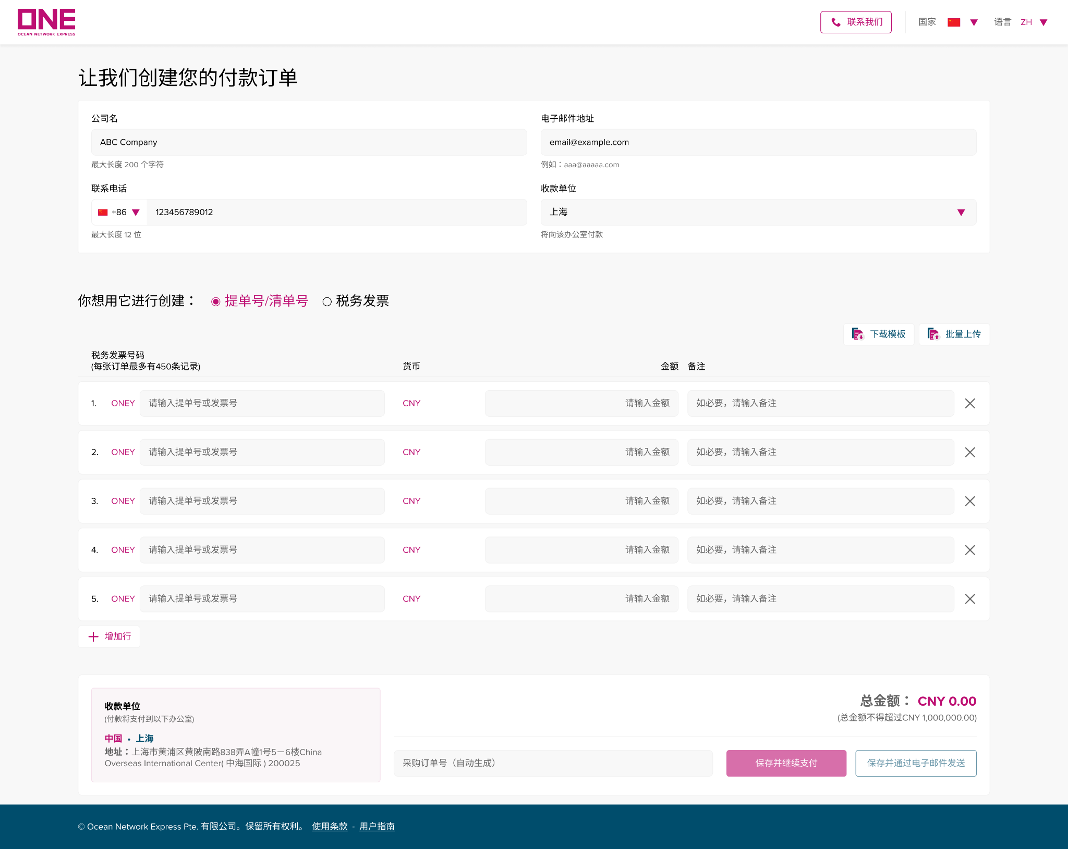
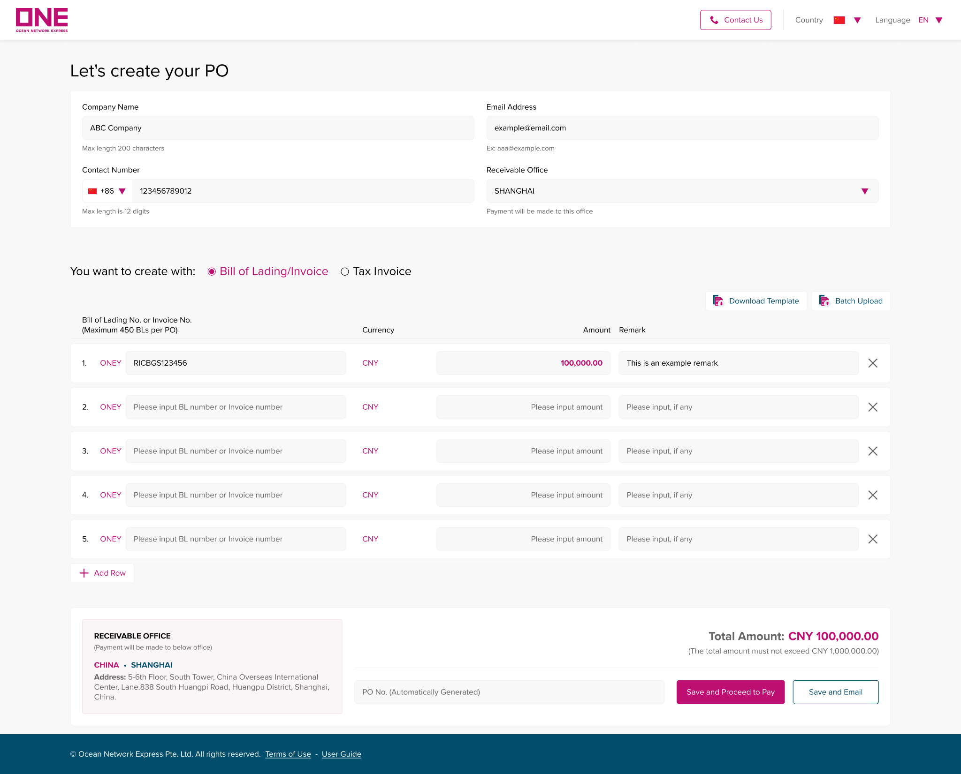
人民币费用结算
RMB on-line payment
访问电子支付门户/ How to Create a PO
第一步：填写付款人信息。
Step 1: Fill in Payer’s information
1.公司名: 请输入您的公司名称。 最大为 200 个字符。
Company Name: Input your company name. The max length is 200 characters.
2.电子邮件地址: 请输入您的电子邮件地址以接收采购订单信息、电子发票等信息。
Email Address: Input your email address to receive PO information.
3.联系电话: 请输入您的联系电话，以便我们在有任何问题时与您联系。
Contact Number: Input your contact number in case of any unanticipated issues.
4.收款单位：请选择签发提单或发票的分支机构。
Receivable Office: Select the branch office that issues your Bill of Lading or Invoice.
1
2
1
2
3
4
3
4

Slide 31
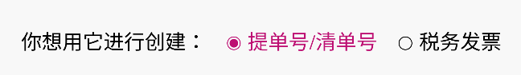
人民币费用结算
RMB on-line payment
访问电子支付门户/ How to Create a PO
第二步：选择采购订单类型。
Step 2: Select type of PO
步骤 3.1: 使用提单创建采购订单
Step 3.1: Create PO with Bill of Lading

Slide 32
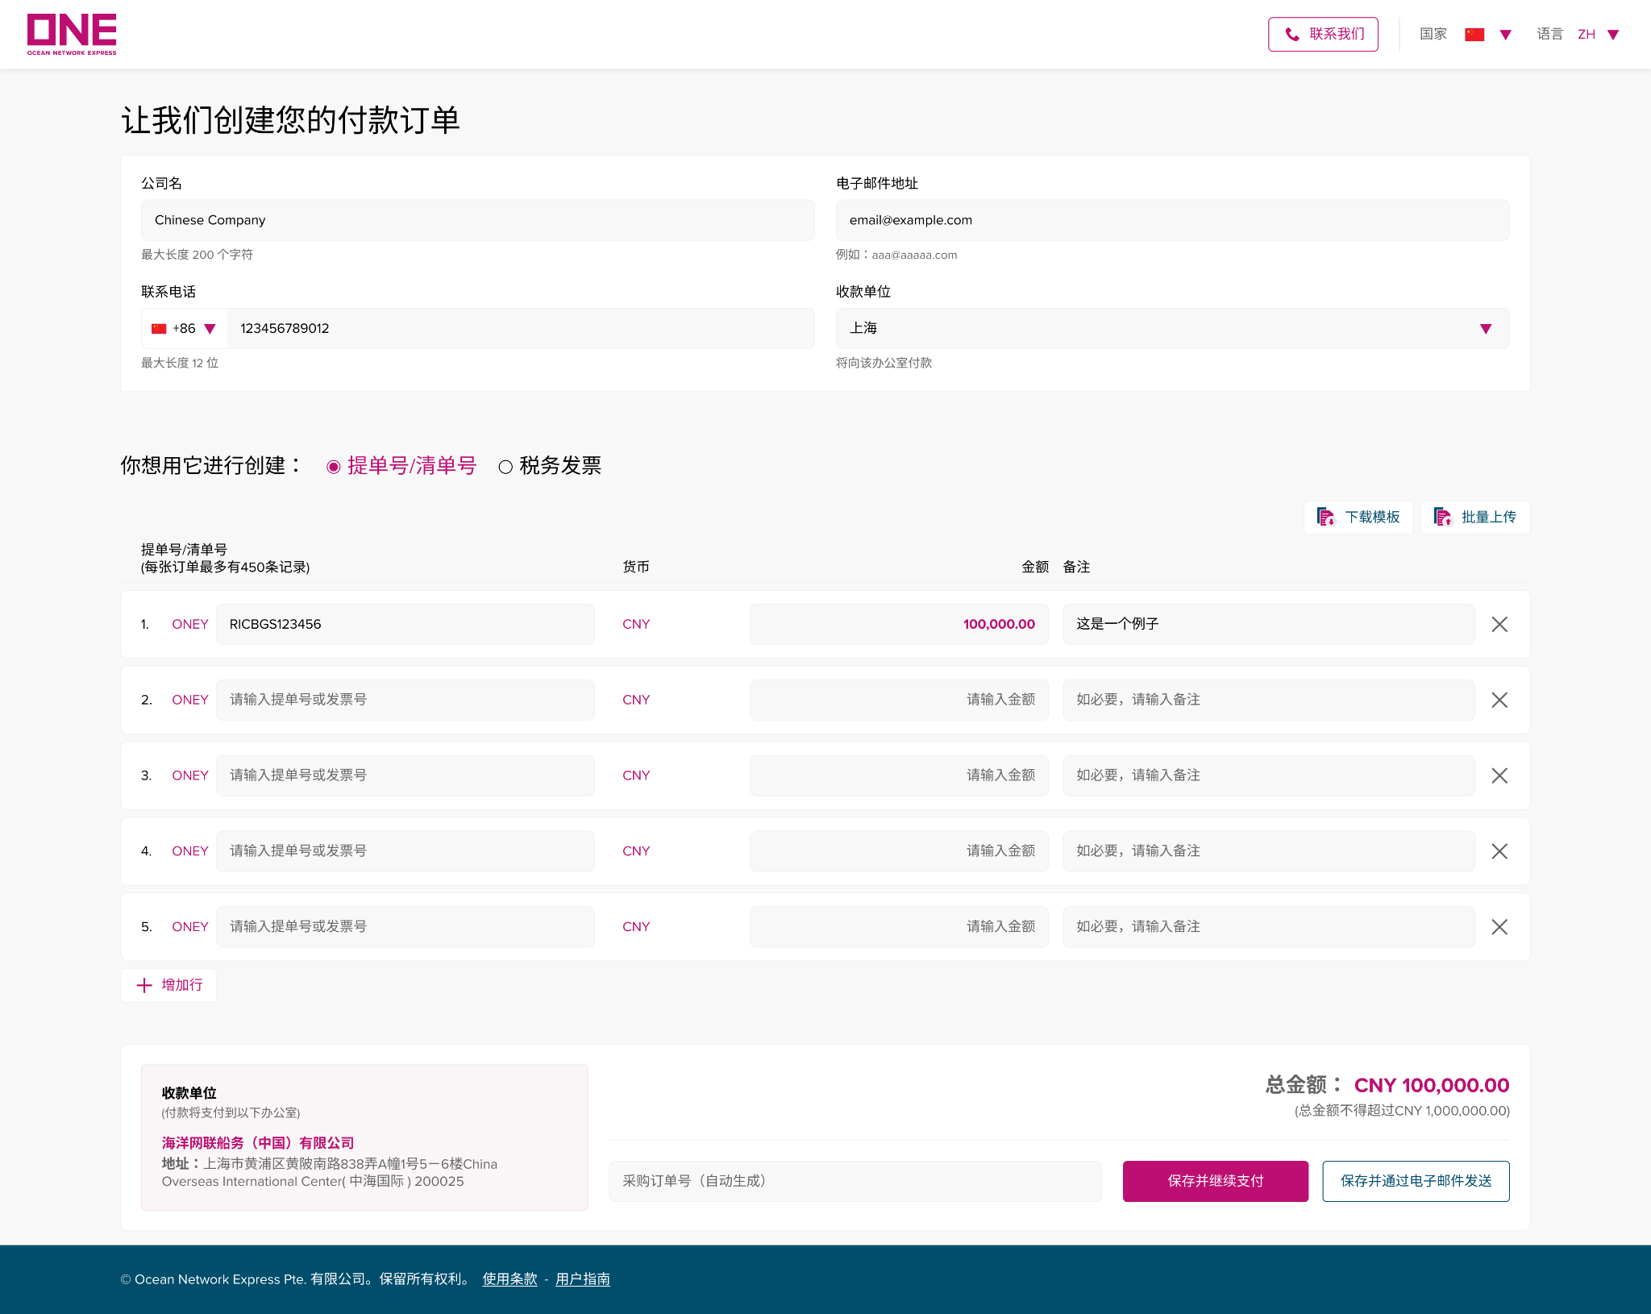

人民币费用结算
RMB on-line payment
使用提单创建采购订单 /How to Create a PO with Bill of Lading
步骤 3.1：填写付款详细信息以创建带有提单的 PO
Step 3.1: Fill in Payment details to create PO with Bill of Lading
5
6
5
6
1
2
3
4
1
2
3
4
7
7
8
8

Slide 33
人民币费用结算
RMB on-line payment
使用提单创建采购订单/How to Create a PO with Bill of Lading
步骤 3.1：填写付款详细信息以创建带有提单的 PO
Step 3.1: Fill in Payment details to create PO with a Bill of Lading
1.提单：请输入您要支付的提单号。 每个 PO 的最大值为 450 条记录。
Bill of Lading: Input the BL No. you would like to pay. The maximum per PO is 450 records.
2.货币：货币设置为用户所属国家的当地货币。
Currency: Currency is set as the local currency of the country where customer belongs.
3.金额：每张提单的金额。
Amount: Amount for each BL.
4.备注： 如有备注，请输入。可以是该记录的参考信息。
Remark: Input remark, if any, which may be reference information of this record.
5.下载模板：点击“下载模板”，将下载一个Excel工作表，您可以填写提单、金额、备注等数据，并使用“批量上传”按钮上传。
Download Template: If you click on ‘Download Template’, an excel worksheet will be downloaded so that you can fill in those data of BL No, Amount, and Remark and upload it by using the ‘Batch Upload’ button.

Slide 34
人民币费用结算
RMB on-line payment
使用提单创建采购订单/How to Create a PO with Bill of Lading
6.批量上传：Excel表格填写完成后，点击“批量上传”即可上传到系统中。 如果批量上传完成，支付页面会呈现excel表中的数据。
Batch Upload: Once you finish filling in on the excel sheet, you can upload it into the system by clicking on ‘Batch upload’. If the batch upload is done, the data in the excel sheet will be presented on the payment page.
7.总金额：所有提单的总金额将显示在“总金额”列表中。 最高金额将由收款方确定 。
Total amount: Total amount of all the BL No. will be displayed in the 'Total Amount' list. The maximum amount will be determined by the receivable office.
8.保存并继续付款：以上项目都填写后，请单击“保存并继续付款”按钮并继续下一步。 它将引导您进入“支付订单”页面，下面将对此进行更详细的说明。
Save and Proceed to Pay: After the above items are all filled in, click on ‘Save and Proceed to Pay’ button to direct to the ‘Pay PO’ page, which will be explained below in more detail.

Slide 35
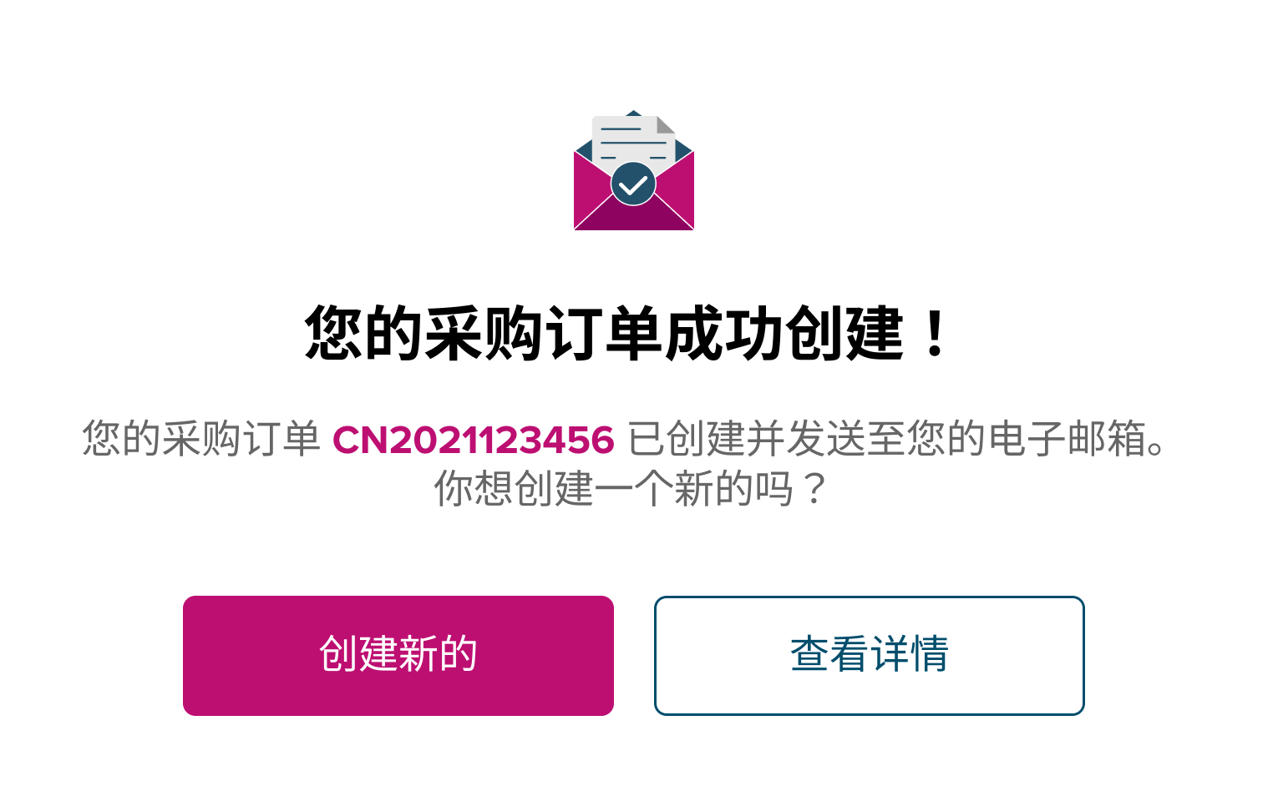
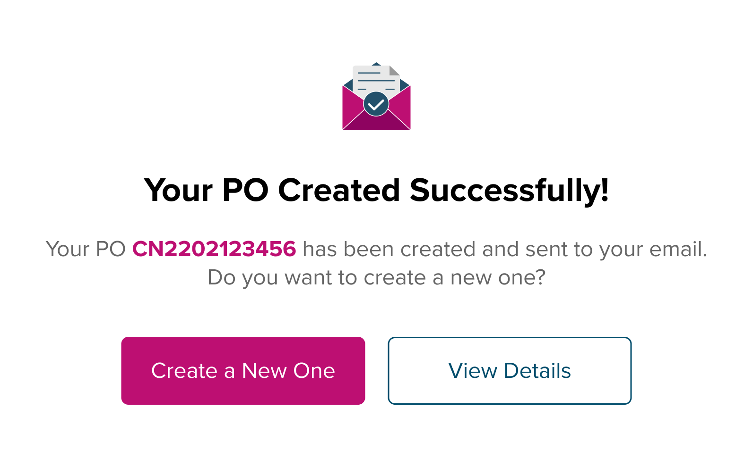
人民币费用结算
RMB on-line payment
如何创建采购订单/How to Create a PO
保存并通过电子邮件发送: 如果您想暂时保存并稍后继续付款，您可以使用“保存并发送电子邮件”。 点击后会弹出一个窗口，显示您的采购订单号，这是自动生成的。 订单号生成后，门户网站会保存并发送通知邮件给您。
Save and Email: If you want to save PO temporarily and proceed with the payment later, you can use ‘Save and Email’ feature. Once it is clicked, a pop-up window appears, shows your PO No. , which is automatically generated. After PO No. is generated, the portal saves it and sends notification mail to you.

Slide 36
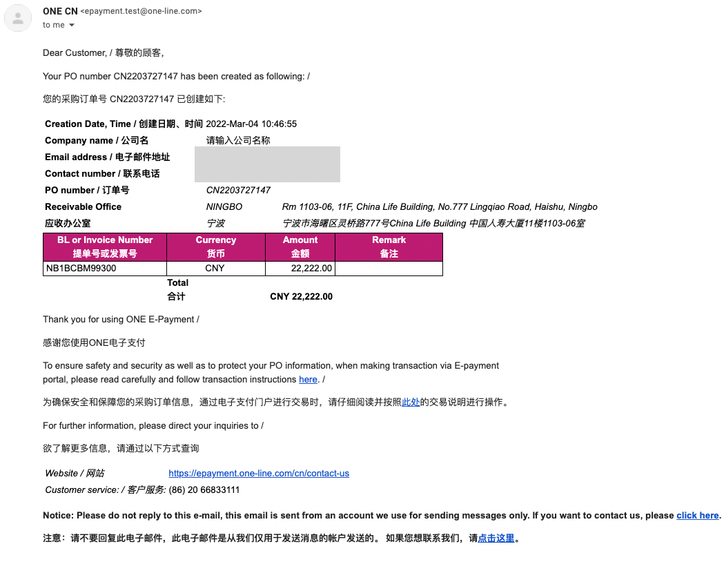
人民币费用结算
RMB on-line payment
使用提单创建采购订单/How to Create a PO with Bill of Lading
当 ePayment 系统成功生成 PO 编号后，您将收到一封邮件，地址是您在创建 PO 页面中输入的电子邮件地址。 下面是示例。 您可以查到 PO 编号和您输入的详细信息。
When PO No. is generated from the ePayment system successfully, you will receive an alert mail addressed to the email address you inputted in the Create PO page. Below is the sample. And, you can find PO No. and the other information you keyed in.

Slide 37
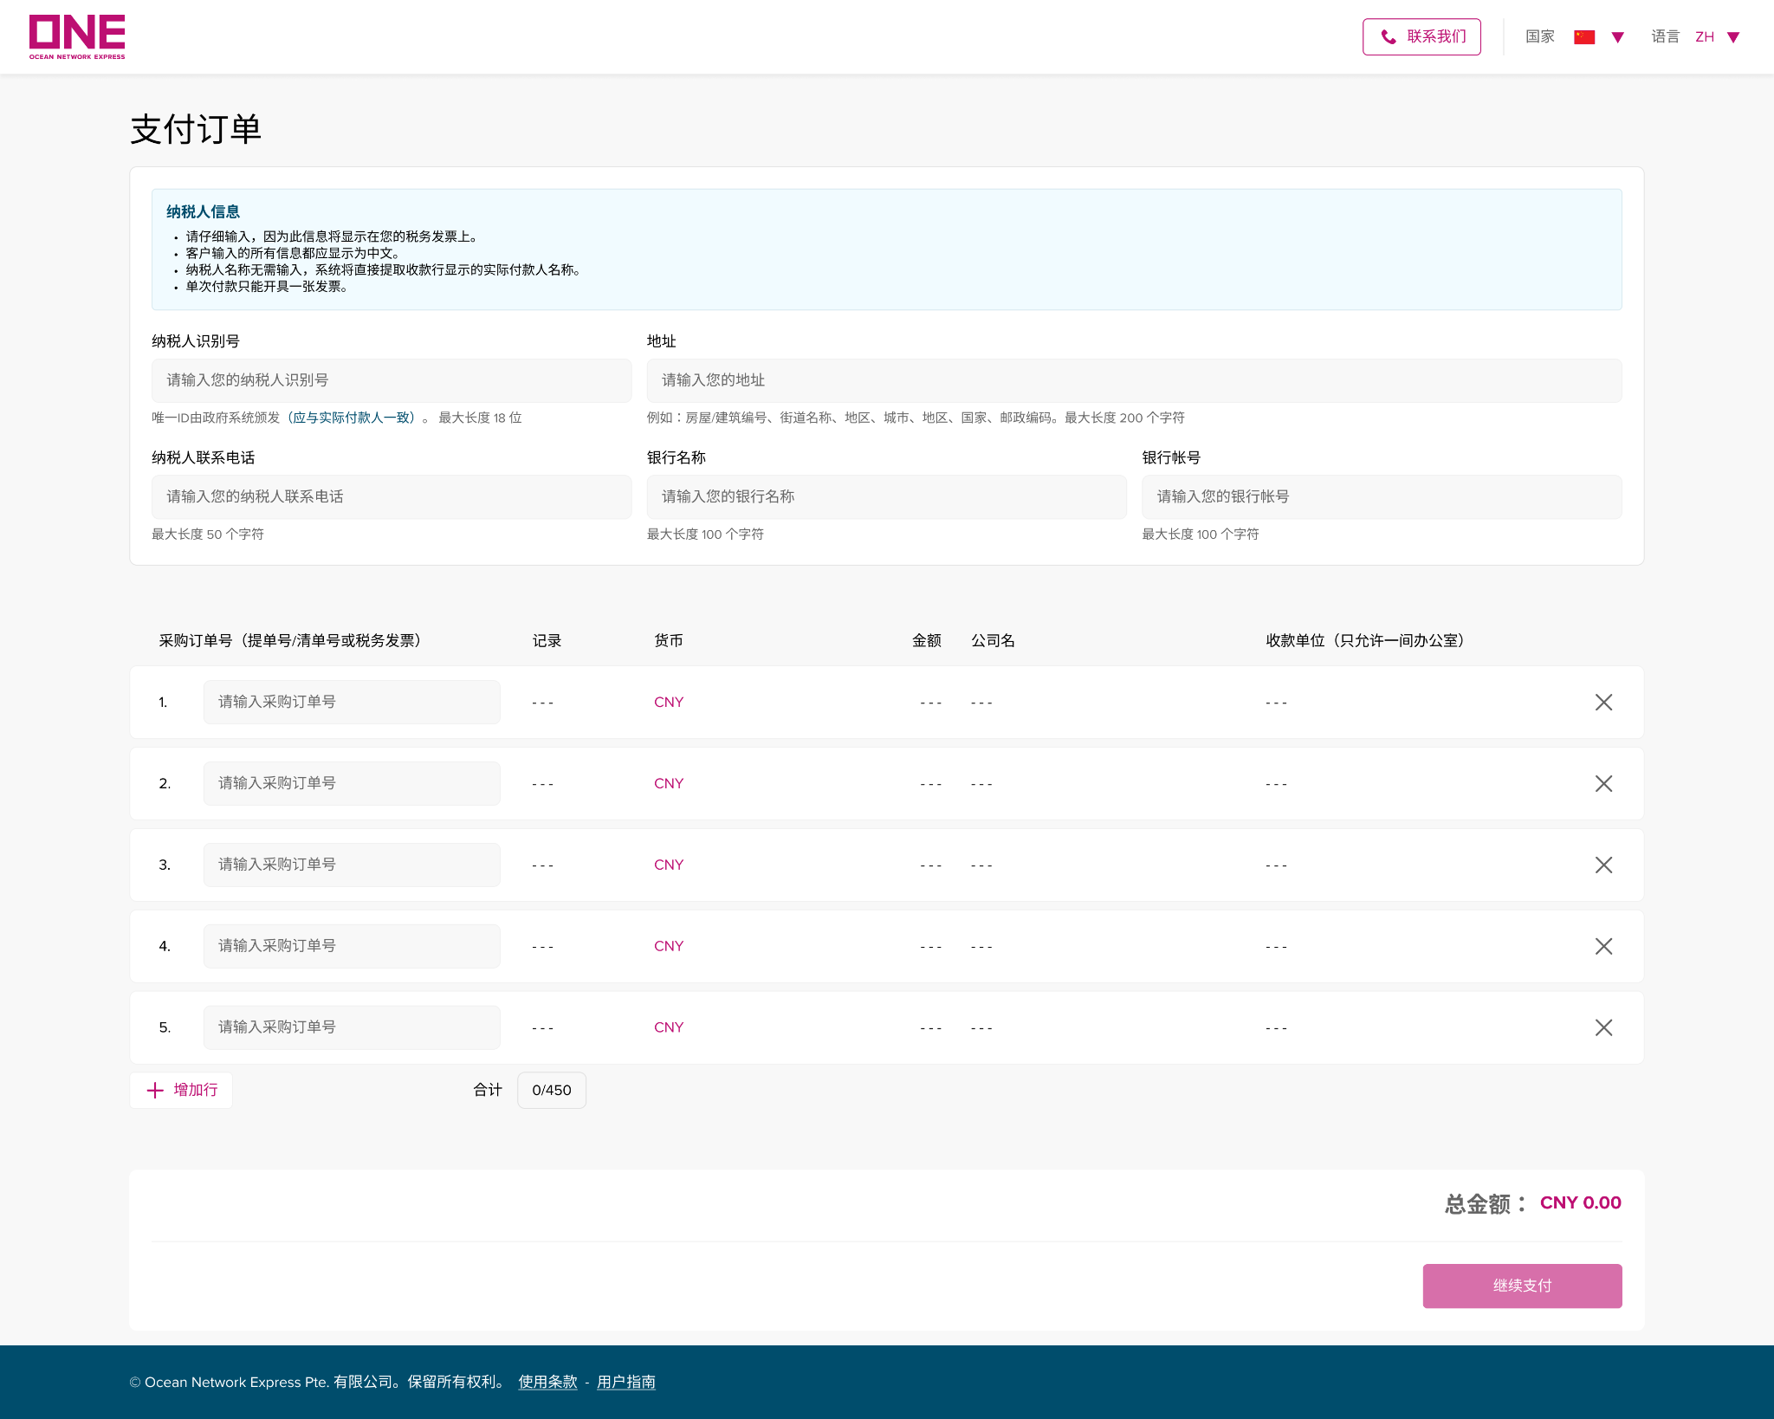
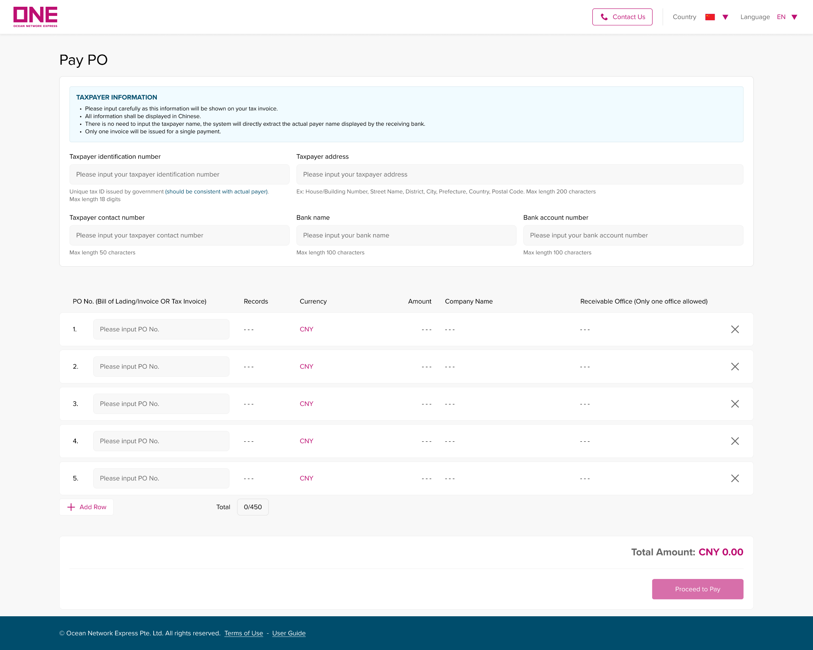
人民币费用结算
RMB on-line payment
如何支付采购订单/How to Pay PO
如果前面的步骤都成功完成，系统将引导您进入“支付订单”页面，或者您可以单击“支付订单”按钮，它将打开一个新的支付订单页面。
The system will direct you to the ‘Pay PO’ page if earlier steps are carried out successfully, or you can click on the "Pay PO” button it to open a new page for paying a PO.

Slide 38
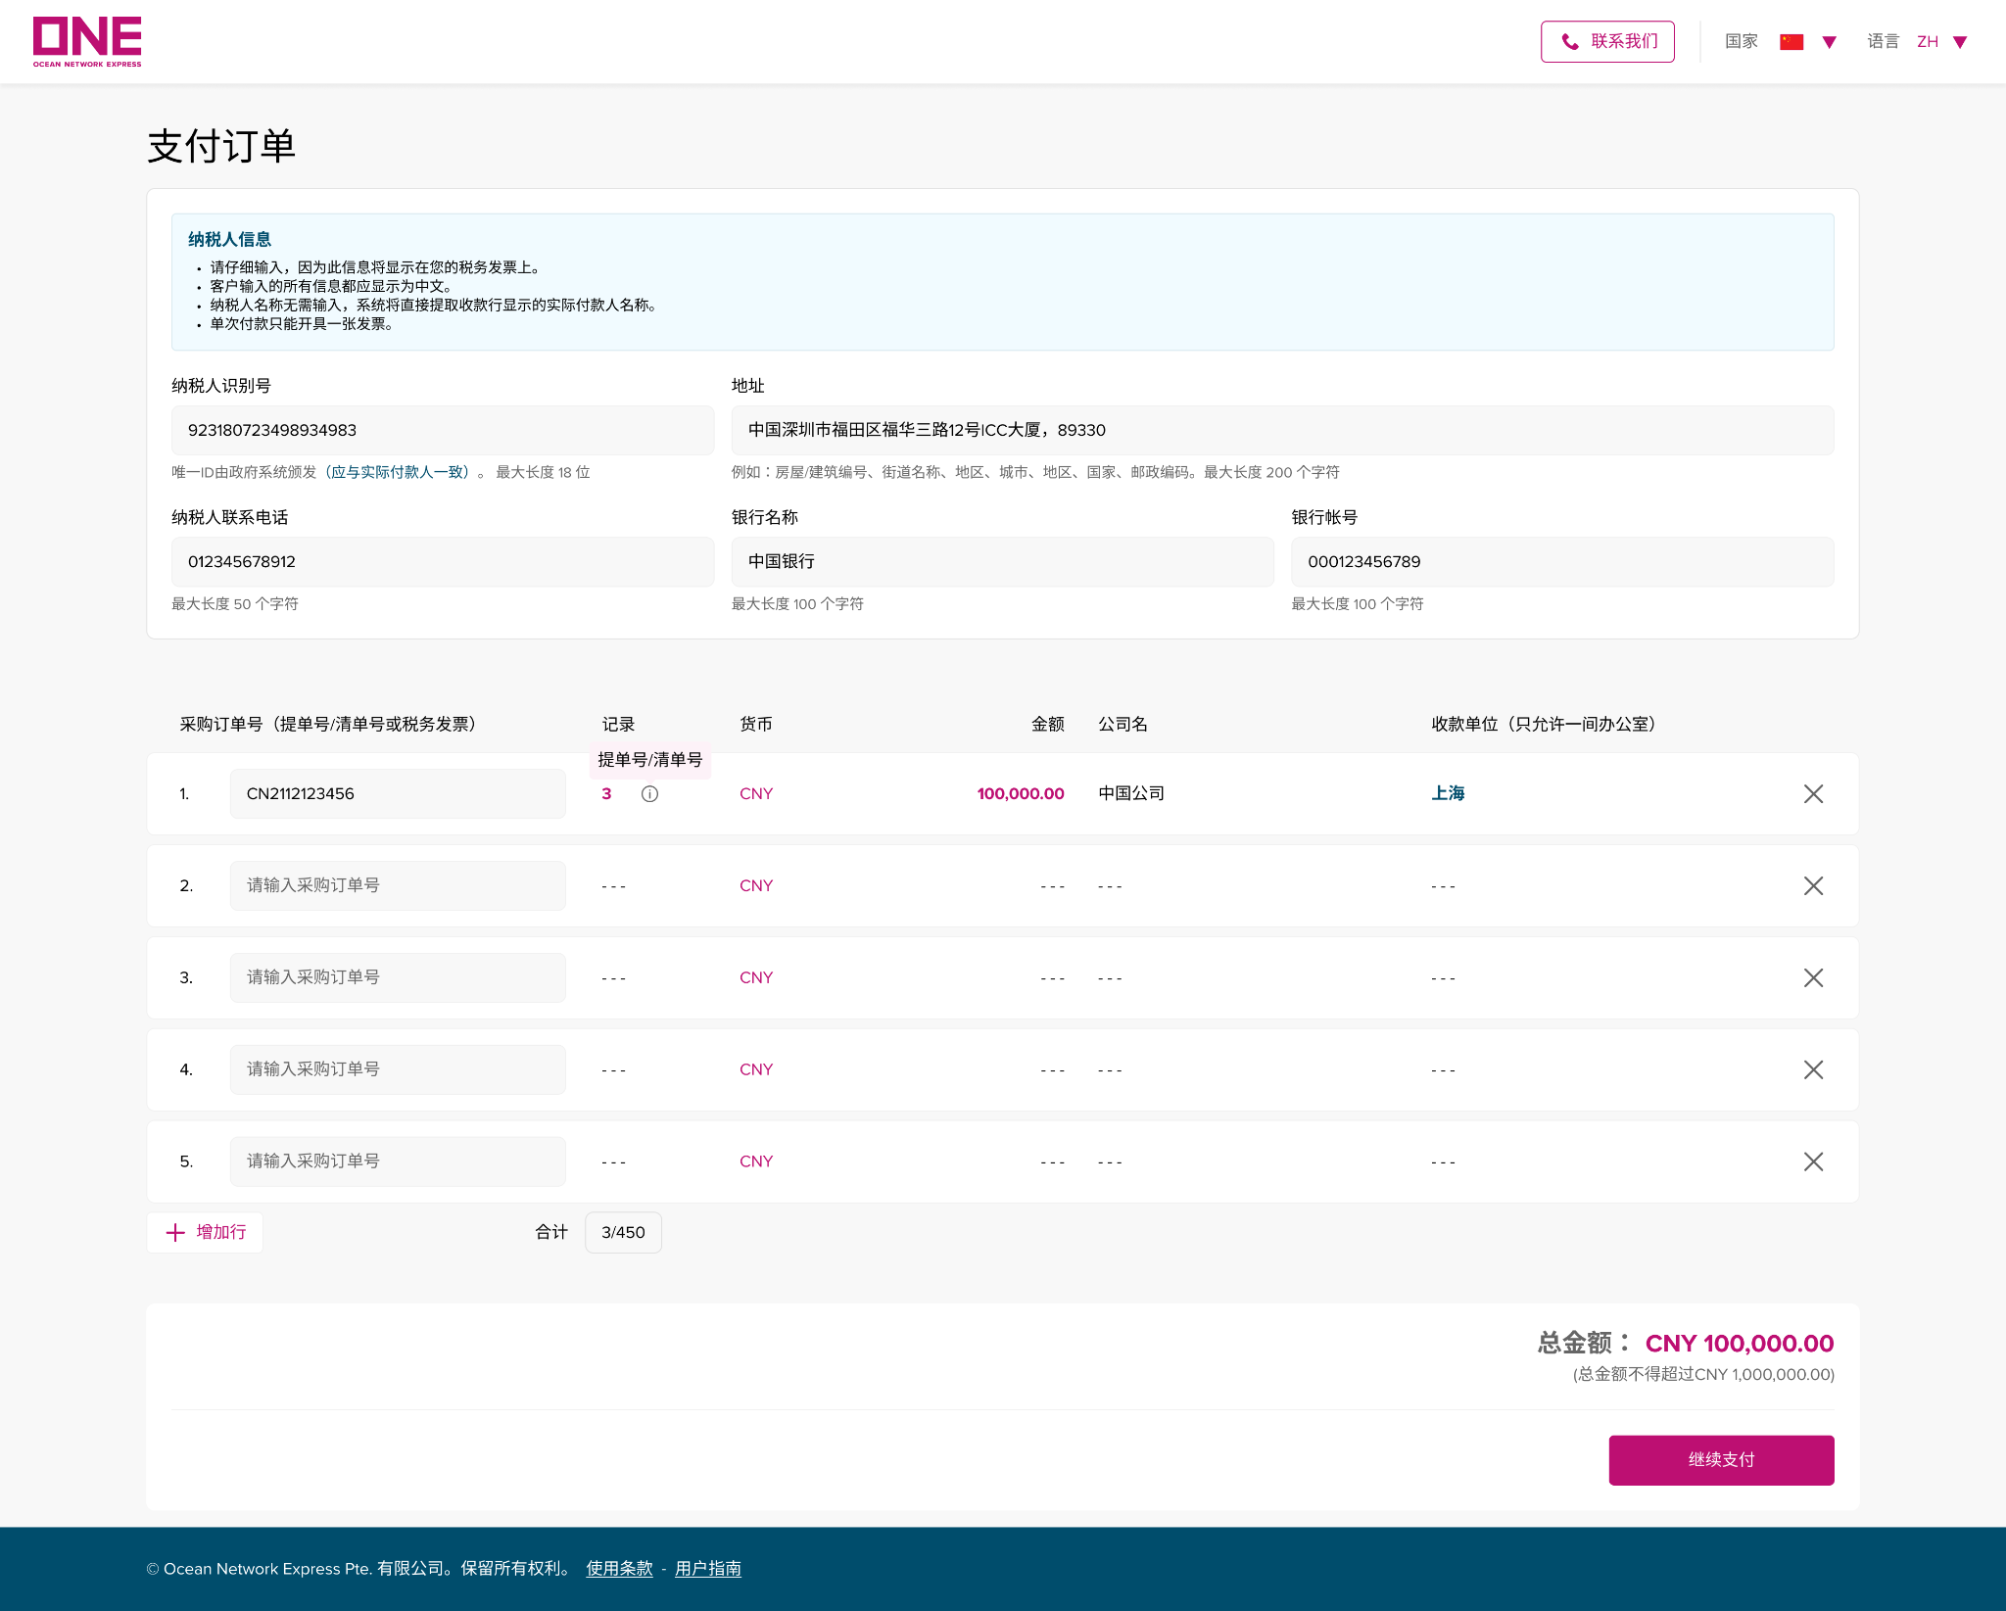
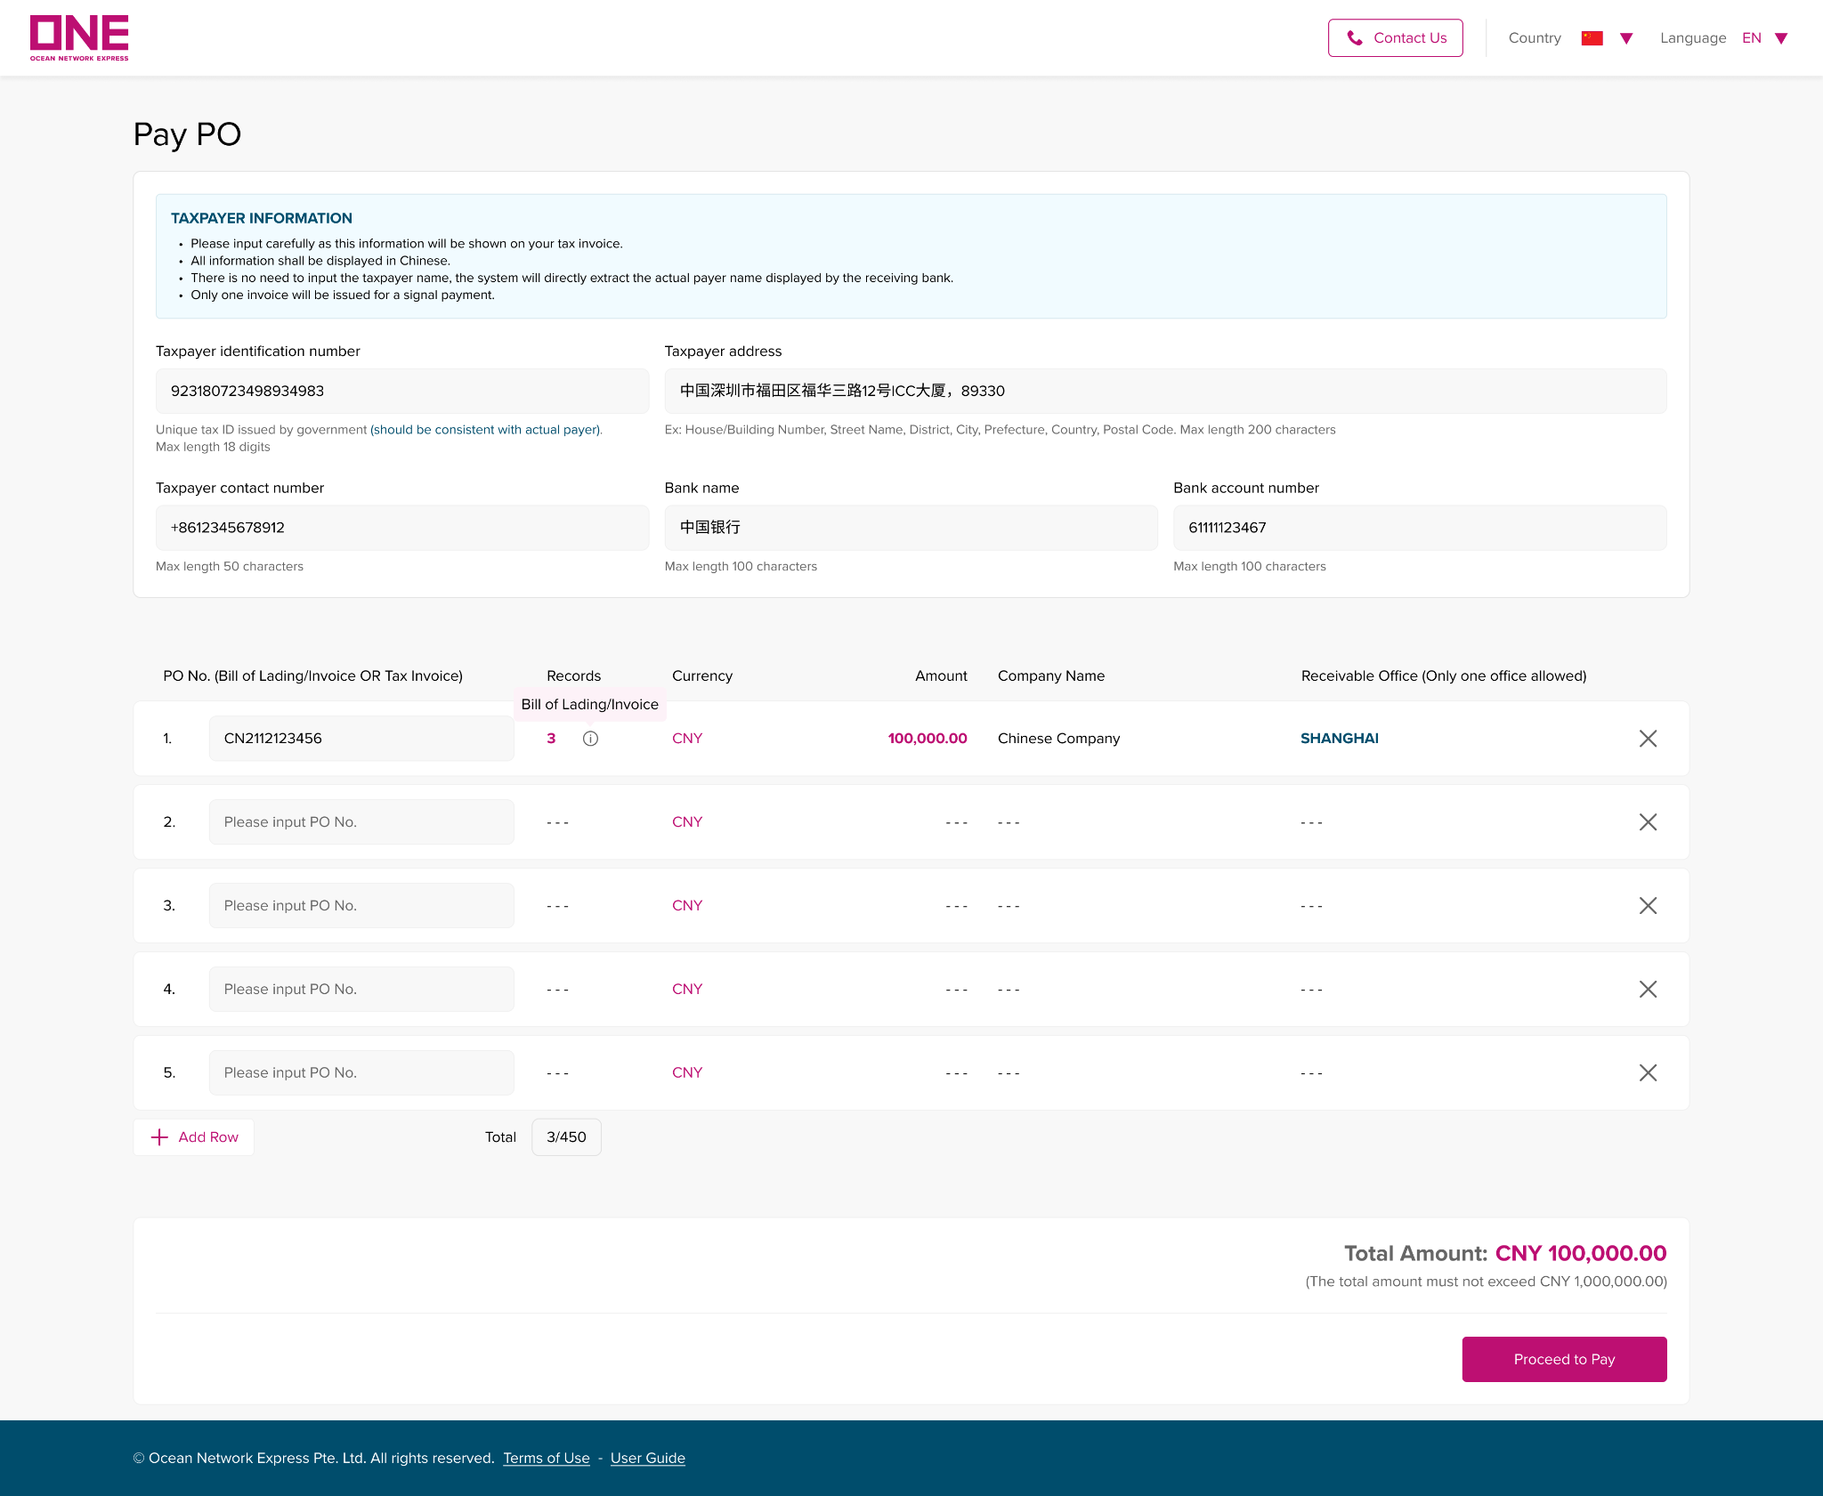
人民币费用结算
RMB on-line payment
如何支付采购订单/How to Pay PO
第 1 步：填写采购订单详细信息。
Step 1: Fill in PO details.
1
2
3
4
5
6
1
2
3
4
5
6
7
7
8
8
9
9

Slide 39
人民币费用结算
RMB on-line payment
如何支付采购订单/How to Pay PO
第 1 步：填写采购订单详细信息。
Step 1: Fill in PO details
1.采购订单号：请输入之前创建的未付款采购订单号（如果您在创建采购订单页面点击“保存并继续付款”，采购订单号将自动显示）。
PO No.: Input unpaid PO No. created earlier (or PO No. will be shown automatically if you click 'Save and Proceed to Pay' from ‘Create PO’ page).
2.记录：记录是指在“创建采购订单”页面中输入的提单号的数量。
Records: ‘Records’ specifies the number of Bill of Lading inputted in the ‘Create PO’ page.
3.货币：货币设置为当地货币。
Currency: Currency is set as local currency.
4.金额：该订单号的金额。
Amount: Total amount is for all of the Bill of Lading
5.公司名：公司名称是您在“创建付款订单”页面中输入的信息。
Company Name: Company name is the information you inputted in the ‘Let’s create you PO’ page.

Slide 40
人民币费用结算
RMB on-line payment
如何支付采购订单/How to Pay PO
6.收款单位: 收款单位是您在“创建付款订单”页面中输入的信息。单次只能向同一个收款单位付款。
Receivable Office: Receivable office is selected in the ‘Create PO’ page. Only one office allowed.
7.合计：显示您在创建 Po 页面输入的提单号的总数量。 总限制为 450。
Total: It shows the total cases of Bill of Lading you inputted from Create Po page. The total limit is 450.
8.总金额：总金额为所有采购订单号的合计金额。
Total Amount: Total amount is for all of the PO No.
9.继续付款：完成上述所有操作后，您可以单击“继续付款”继续下一步。 单击后，将出现一个弹出窗口。
Proceed to Pay: Once the above is all finished, you can click on ‘Proceed to Pay’ to move on to the next steps. Once it is clicked, a pop-up window will appear.

Slide 41
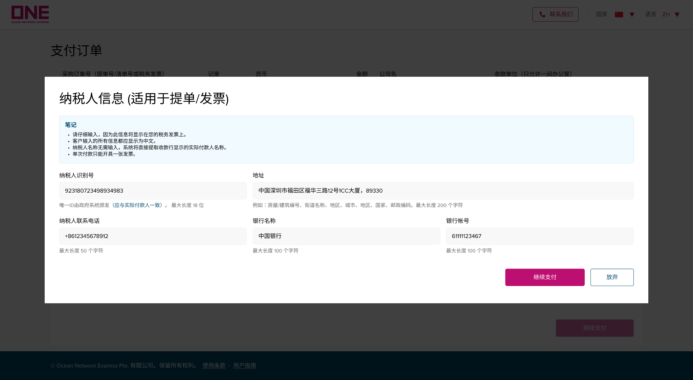
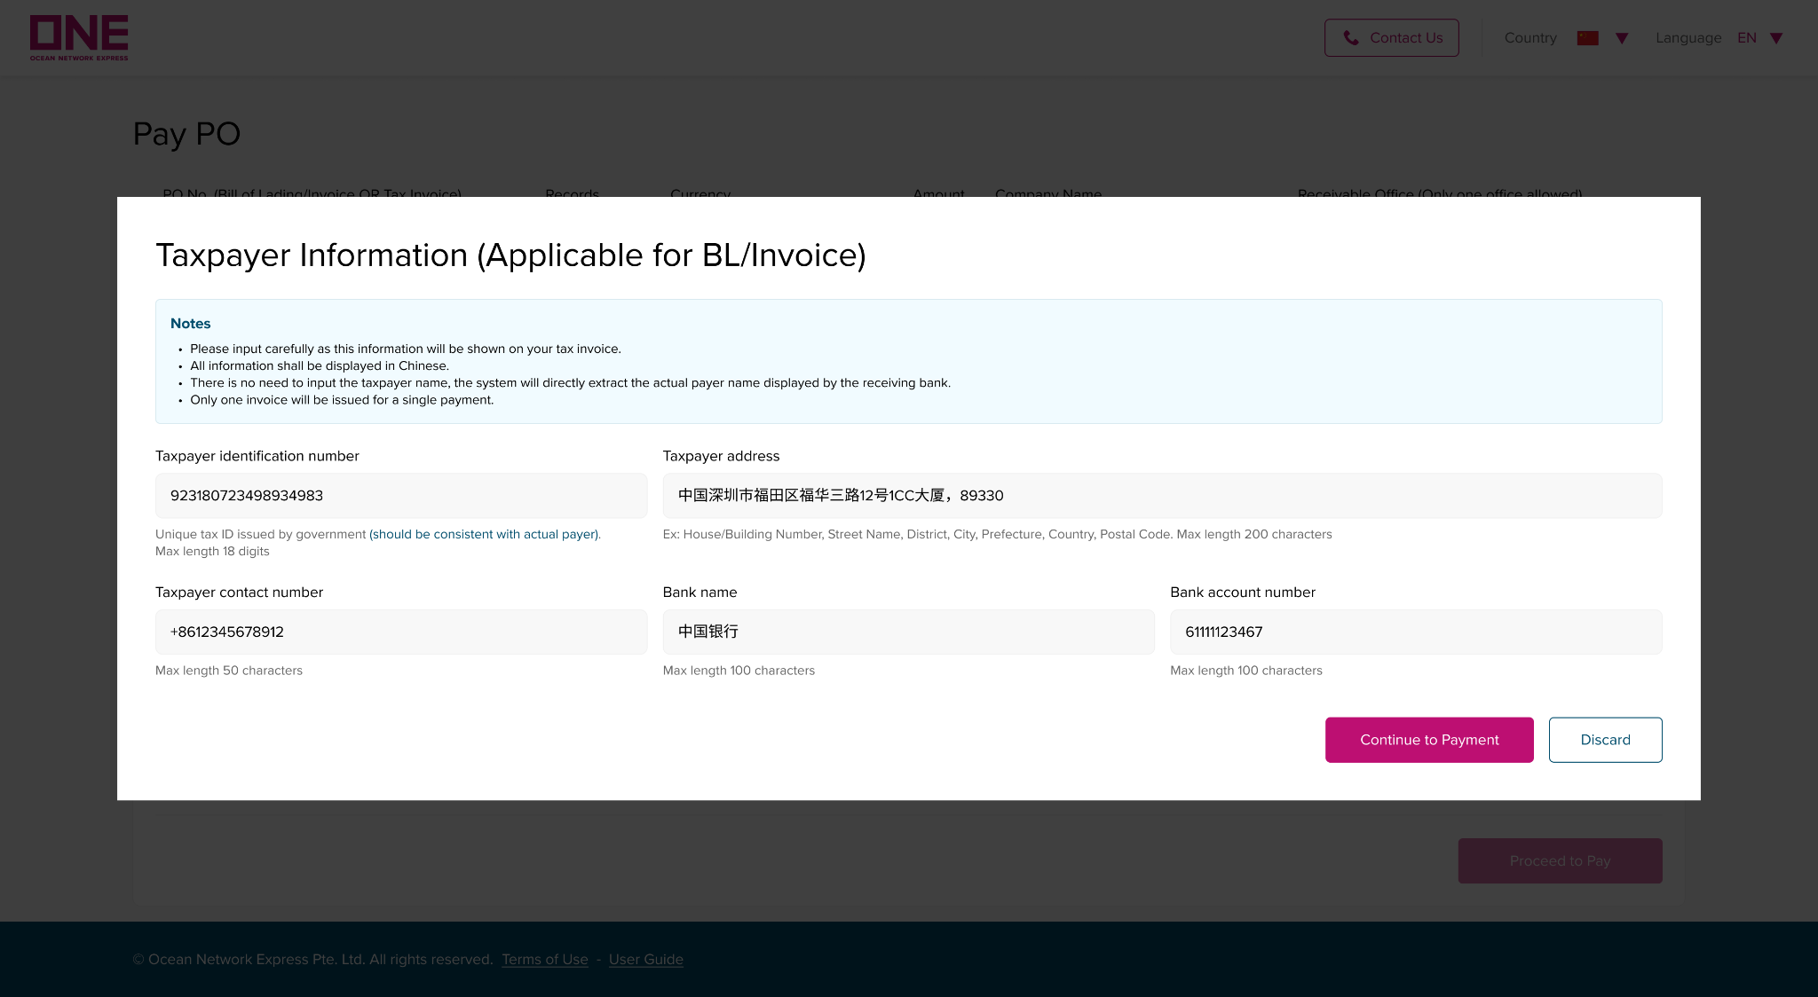
人民币费用结算
RMB on-line payment
如何支付采购订单/How to Pay PO
使用提单号的采购订单进行支付时，您需要先输入生成电子发票所需的纳税人开票信息，然后才能继续链接到支付网关
When proceeding to pay with PO of Bill of Lading, you need to input the Taxpayer Information for using the generate the e-Tax Invoice then can continue navigates to the payment gateway.
1
2
1
2
3
4
5
3
4
5

Slide 42
人民币费用结算
RMB on-line payment
如何支付采购订单/How to Pay PO
第一步：填写纳税人信息
Step 1: Fill in Taxpayer Information details
1.税号：请输入您的纳税人识别号。 由政府签发（应与实际付款人一致）。 最大长度 18 位。
Tax Identification Number.: Input your unique Tax Identification Number, which is issued by the government and should be consistent with the actual payer. Max length 18 digits.
2.纳税人地址：请输入您的地址。 最大长度 200 个字符。
Taxpayer Address: Input your registered address. Max length is 200 characters.
3.纳税人联系电话：创建采购订单页面点击“保存并继续付款”后，此字段会自动填写。 但是，可以随时修改/输入您想在税务发票上显示的号码。
Taxpayer Contact Number : This field is automatically fulfilled when clicking “Save and Proceed to Pay” from the ‘Create PO’ page. However, please feel free to modify/input the number you want to show on Tax Invoice.
4.银行名称：您要在税务发票上显示的银行名称。
Bank Name: The name of the bank account that you want to show on the Tax Invoice.
5.银行帐号：您要在税务发票上显示的银行账号。
Bank Account Number: The number of bank accounts you want to show on the Tax Invoice.
请注意: 税务发票中显示的发票付款人抬头将直接使用收款行提供的收款信息中实际付款人名称。
Please Note: The actual payer name shown in the Tax Invoice will be retrieved from bank information by ePayment, followed by the bank account.

Slide 43
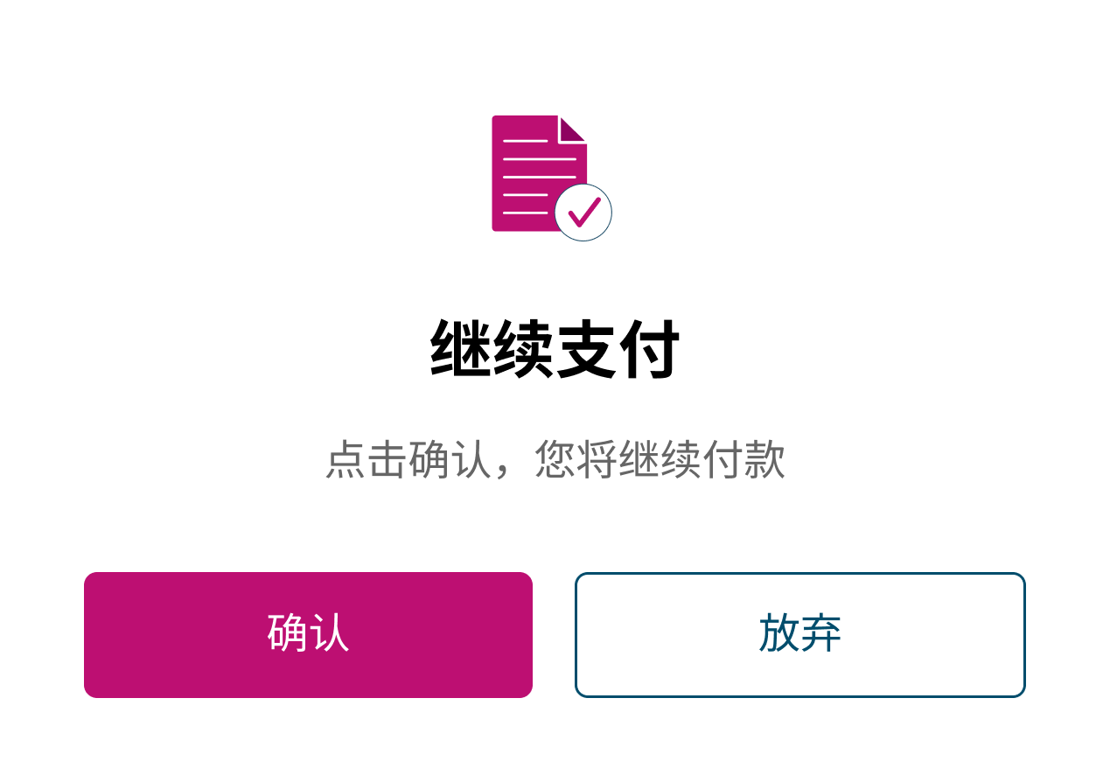
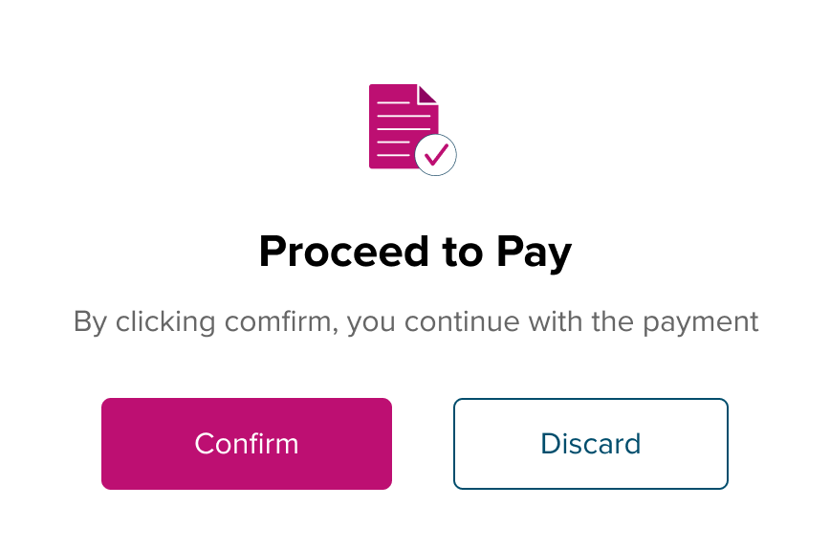
人民币费用结算
RMB on-line payment
如何支付采购订单/How to Pay PO
第 2 步：完成付款
点击“确认”继续付款。
Step 2: Complete Payment
Click on "Confirm" to proceed with the payment.
When you click on "Confirm" on Proceed to Pay, the system navigates to the Payment Gateway of “Bank of China” for you to choose the payment method.
当您在付款界面点击“确认”时，系统将跳转至“中国银行”支付网关，供您选择付款方式。

Slide 44
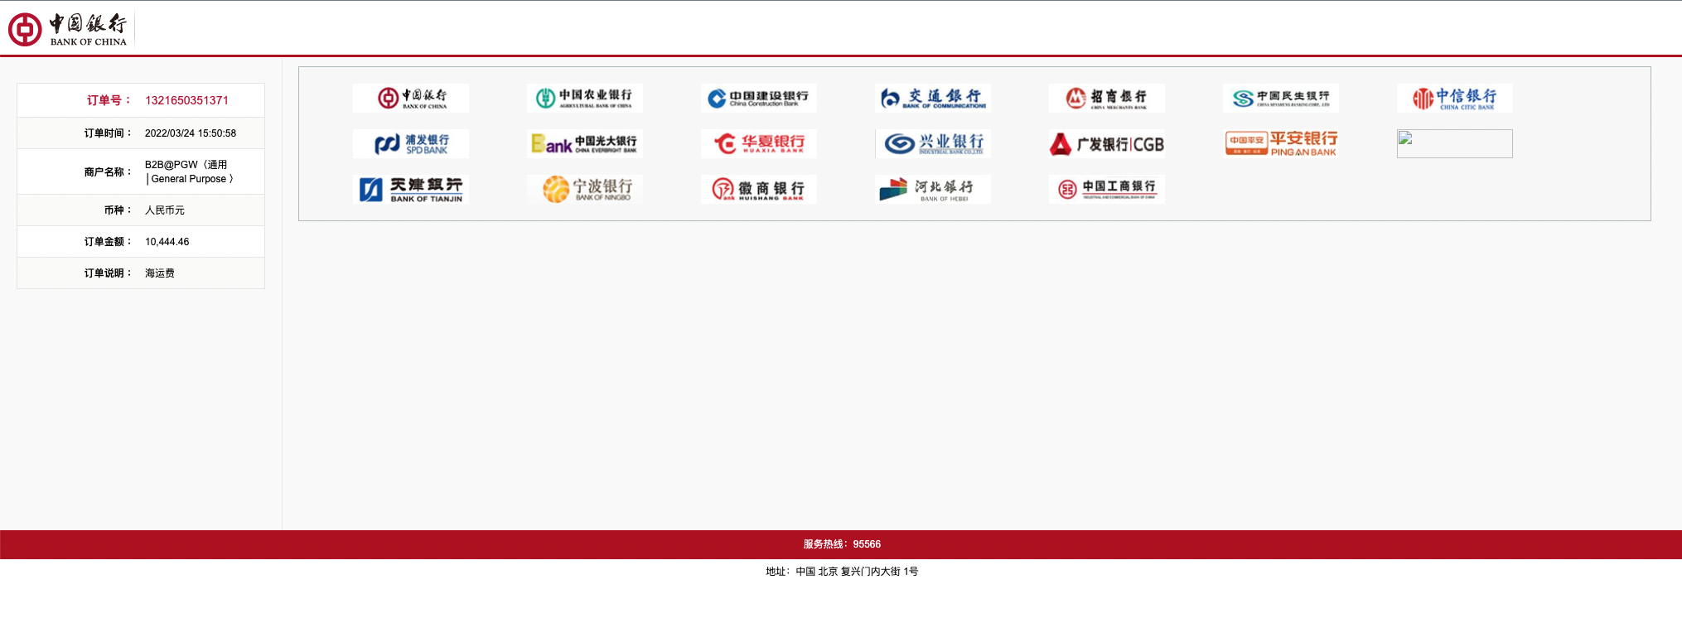

人民币费用结算
RMB on-line payment
如何支付采购订单/How to Pay PO
请选择您需要的银行并按照说明完成付款
Please choose your preferable bank and follow the instruction to complete the payment.
注意：如果您想取消支付，请关闭您的浏览器。
Note: If you want to cancel the payment, please close your browser.

Slide 45
人民币费用结算
RMB on-line payment
如何支付采购订单/How to Pay PO
01: 环境： 国家
如果您访问 ePayment 门户，系统将检测您所在的国家/地区，它将显示在页面的标题处。 而且，电子支付门户将据此决定当地货币。
Setting: Country
If you access the ePayment portal, the system will detect the country you are located, shown on the header of the page. And, according to the location detected, the ePayment portal will decide the local currency.
02: 其他： 联系我们
如果您需要联系 ONE 以获取电子支付服务，您可以通过单击“联系我们”图标来了解办公地址、联系电话、电子邮件和工作时间。
Others: Contact Us
In case you need to contact ONE for ePayment service, you can refer to the office address, contact number, email, and working hours by clicking on the ‘Contact Us’ icon.
03: 其他：使用条款
如果您点击页面底部的“使用条款”，门户将打开一个新的使用条款页面。
Others: Terms of Use
If you click on ‘Terms of Use’ at the bottom of the page, the portal will open ‘Terms of Use’ in a new tab.

Slide 46
美金费用结算
USD payment on invoice
美元付款成功后付款通知格式要求：
USD payment advice requirement:
邮件主题： 公司名称+付款日期+付款笔数+币种合计金额
例：海天国际-2022-07-16已支付2笔款项 美金 合计USD2800
Email subject : Company name + date of payment + Number of payments + Currency & Total amount
Sample: Haitian International – 2022-07-16 paid 2 payments Total USD2800
邮件正文：
Email body:
1. 公司名称+付款日期+付款笔数+币种合计金额
Company name + date of payment + Number of payments + Currency & Total amount
2. 按照要求填写附件
Fill in the attachment as required
3. 附上邮件提及的水单
Attach the bank slip mentioned in the email
请将此邮件发送至： cn.db.collection@one-line.com
Please send email to: cn.db.collection@one-line.com

Slide 47
The End

